Slide 1
The Retrievers PDR
Preliminary Definition Review
Names: Anton, Nathan, Aidan, Phoenix, Siddhesh, Zac & Daniel
Team: The Retrievers
Date: 08/12/25
Notes:
Diagrams at https://lucid.app/folder/invitations/accept/inv_be86b371-bc8c-412d-b2b2-73c1ee80438e
Aidan

Slide 2
PDR Outline
Concept
Concept Definition
Measures of Effectiveness
Technical Schedule
Requirements
Solution
Design Solution Definition
Diagrams
Subsystems & ConOp
Interfaces
Implementation Plans
Technical Measures of Effectiveness
Validation Plans
Notes:
AIdan

Slide 3
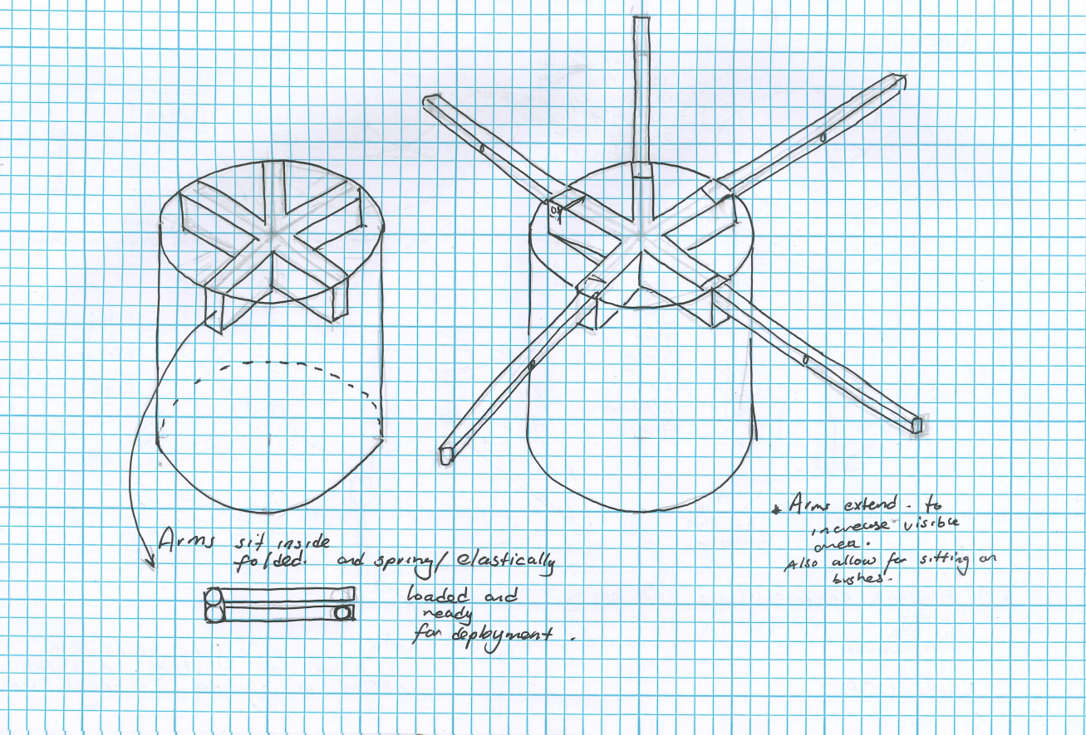
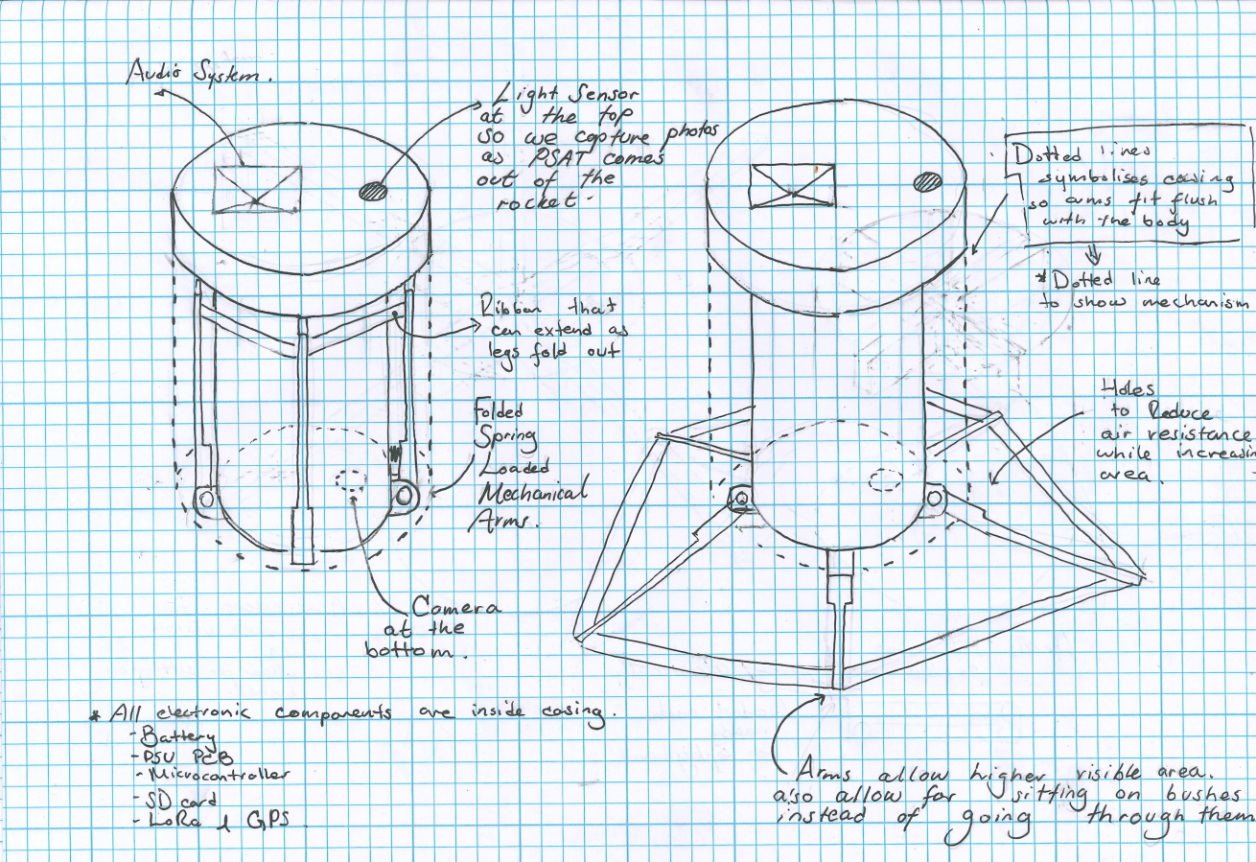
1. Concept
Create a payload that is easily retrievable in under 60 minutes.
Notes:
Phoenix

Slide 4
Mission Objective
Confirm electrical signs of life of PSAT via pings over LoRa
Receive GPS location of the PSAT over LoRa
Produce a recognisable sound for close range retrievability
Detect when the PSAT is released from the rocket
At least 2 passive (backup) and 2 active recovery methods.
Record video of PSAT deployment from PSAT perspective.
Take photographs during descent every 5 seconds
Notes:
Phoenix

Slide 5
Measures of Effectiveness
Time taken to recover PSAT
PSAT visible from 500m away. (On flat ground)
Deployables deploy successfully.
Captured a photo during descent
Target: Retrieve the PSAT in under an hour
Notes:
Measures of effectiveness is how you measure your success, target is the number that tells you that you succeeded
Phoenix

Slide 6
Technical Schedule
LAUNCH
Test Launch
Start
MCR
PDR
CDR
FRR
First Order
Second Order
Timeline:
8th December - Preliminary Design Review (PDR)
19th January- Critical Design Review (CDR)
February - Test Launch
Start of March - Launch & Flight Readiness Review (FRR)
Oct
Nov
Dec
Jan
Feb
Mar
Notes:
Aidan

Slide 7
To be done by Preliminary Design Review (PDR)
LAUNCH
Start
MCR
PDR
CDR
FRR
First Order
Second Order
Oct
Nov
Dec
Jan
Feb
Mar
Minimum Minimum Viable Product (GPS + LoRa - Demo later)
Electrical/Software Based Prototype (breadboard) complete
LoRa + GPS working - Beacon mode + command processing + data send/recv + GPS
Passive + Active recovery methods working - GPS + Servo (Folding mech.) + Buzzers
Air horn/Sound system - Buzzers as prototype ^
Physical/Mechanical Based Prototype complete
Folding/Origami mechanism - Folding arms prototypes + Final cad model
Notes:
Aidan
All done

Slide 8
To be done by Critical Design Review (CDR)
LAUNCH
Start
MCR
PDR
CDR
FRR
First Order
Second Order
Oct
Nov
Dec
Jan
Feb
Mar
Actual Minimum viable product complete
Passive methods working reliably (Unfolding for better visual confirmation + Reflective tape)
Active methods working reliably (LoRa/GPS + audio)
Preliminary Shock tests do not cause recovery methods to fail
Triangulation via LoRa works within a degree of accuracy (~3m)
Prototype LoRa does not support this natively, so uncertain if possible.
Secondary objectives complete (Camera)
Camera activation methods working
Successful recording of test-deployment and interval-based image captures.
Testing Suite (Prelaunch + General) complete
`
Notes:
Aidan
Additions in green

Slide 9
To be done by Flight Readiness Review (FRR)
LAUNCH
Start
MCR
PDR
CDR
FRR
First Order
Second Order
Oct
Nov
Dec
Jan
Feb
Mar
Be flight ready!
Successful combination of secondary and primary objectives into single PSAT
Successful demonstration of critical systems:
LoRa triangulation
PSAT folding and unfolding
Audio pinging
GPS transmission working
Successful shock test in complete form
Notes:
Aidan
Mostly the same, just not sure about lora triangulation.

Slide 10
High Level Requirements
Req. Code | Description | Justification
SYS-01 | The PSAT shall have at least 3 active and 1 passive retrieval systems. | Having many retrieval systems ensures that we have a backup in case of system failure.
SYS-02 | The PSAT shall act autonomously during flight. | Avoids human error and reduces latency on operations
SYS-03 | The PSAT shall activate high-power electronics once, based on intervals or received commands | To preserve power and share its location for recovery
SYS-04 | The PSAT shall detect when it leaves the rocket body | To determine when to activate other systems that are not required while in the rocket
SYS-05 | The PSAT shall have battery life span of at least 4 hours after landing | To ensure that in worst case scenarios, retrieval subsystems are still able to be activated late into search.
SYS-06 | The PSAT shall transmit status updates to the ground team in regular intervals | Allows us to detect any failures during and after launch, such as lost or interrupted communication.
SYS-07 | The PSAT shall be able to physically withstand forces of () and temperatures of (-30°C to 60°C) throughout the duration of operation | Allows for system to survive launch, deployment, and impact.
Notes:
Siddhesh
Reminder - don’t need to be too indepth about this when speaking.
USE THE WORD SHAAALL !!!!!!

Slide 11
Subsystem Requirements - Camera
Req. Code | Description | Parent Requirement | Justification
CAM-01 | The camera shall start operating within 500ms of deployment. | SYS-02 SYS-03 | To turn on camera to allow for video capture of deployment and intermittent photos during landing.
CAM-02 | The camera shall stop operating within 5 seconds of landing | SYS-02 SYS-03 | To save on battery power, as photos are not needed when landed.
CAM-03 | The camera power consumption shall not exceed 20% of total battery capacity throughout operation | SYS-05 | To ensure the camera system does not overuse power that is needed by other components.
CAM-04 | The camera shall not crack during initial launch conditions | SYS-07 | To achieve recoverability of camera system.
CAM-05 | The camera shall be able to take and store images throughout the entire flight | SYS-02 SYS-03 SYS-07 | To ensure that the camera operates seamlessly
Notes:
Siddhesh

Slide 12
Subsystem Requirements - Active Retrieval
Req. Code | Description | Parent Requirement | Justification
AR-01 | The LoRa shall be able to transmit gps data every 5 seconds while receiving commands from external sources | SYS-01 SYS-02 SYS-03 SYS-06 | To communicate signs of life and make tracking and recovery easier.
AR-02 | The LoRa shall operate within 10km | SYS-02 SYS-06 | To ensure sufficient range while operating.
AR-03 | The LoRa shall operate within a temperature range between -40°C to 85°C (REF LINK) | SYS-07 | To operate within a safe temperatures range.
AR-04 | The LoRa shall continue to transmit data once it has landed. | SYS-03 SYS-05 SYS-06 | To enable continuous communication for retrieval.
AR-05 | The audio system shall activate at command via LoRa. | SYS-01 | To use audio system only in close proximity, preserving battery.
AR-06 | The PSAT shall have a folding mechanism to increase its visible area. | SYS-01 | This allows ease of retrieval by: 1. Ensuring that it does not fall deeply into bushes. 2. Ensuring that we can more easily identify the landed PSAT.
Notes:
Siddhesh

Slide 13
Subsystem Requirements - Passive Retrieval
Req. Code | Description | Parent Requirement | Justification
PR-01 | The PSAT’s LoRa and firmware shall detect disconnections with home base and activate relevant Active Retrieval Subsystems such as Audio at regular intervals. | SYS-01 SYS-04 | This ensures that in the event of LoRa failure other subsystems that can be used somewhat passively are activated.
PR-02 | The PSAT shall be of bright contrasting colour and/or covered in reflective material. | SYS-01 PR-01 | To allow for improved visual location of PSAT.
Notes:
Phoenix
These are our subsystem requirements for passive retrieval. These system requirements ensure that in the event of a critical failure, the PSAT still has backup systems that allow us to retrieve the PSAT

Slide 14
2. Solution
Mission Design

Slide 15
Design Solution Definition
One member found a small film camera to take photos. We will mount it to a capsule & create a system to automatically take photos.
There will be a lot of chaotic movement on descent, so need a way to stablize the camera on descent.
Photos will look best at apogee, but will have high motion blur at deployment. So the shutter will be programmed to fire at set times.
Film must be contained onboard, and in the dark at all times.
We will be removing the camera’s viewfinder which means we cannot rely on the camera’s body to block all the light.

Slide 16
Design Solution Definition
The PSAT will utilise a foldable arm mechanism to increase its visible area.
The PSATs arms will be attached to reflective tape and ribbons to increase the likelihood of retrieval.
The PSATs arms are meant to be caught within bushes to ensure easier retrievability.
We will use a sound emitter (currently a small buzzer) to aid us in finding the PSAT. It will make a loud sound when it receives a signal from us. It will do this to conserve power.
We will be using a small ESP camera module to take photos with. We decided on this camera as it wont take up much space.
The Psat will use LoRa and GPS to determine the general location of the landing zone and use the methods above to pinpoint the location.
Notes:
Phoenix

Slide 17
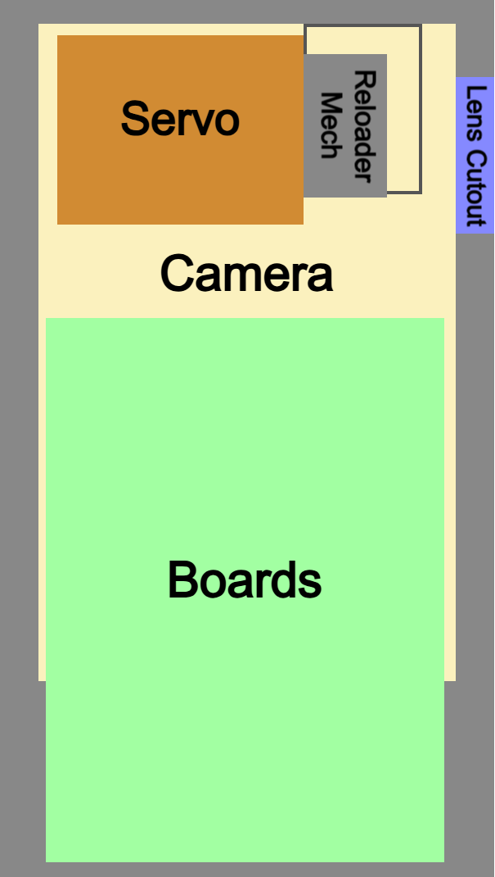
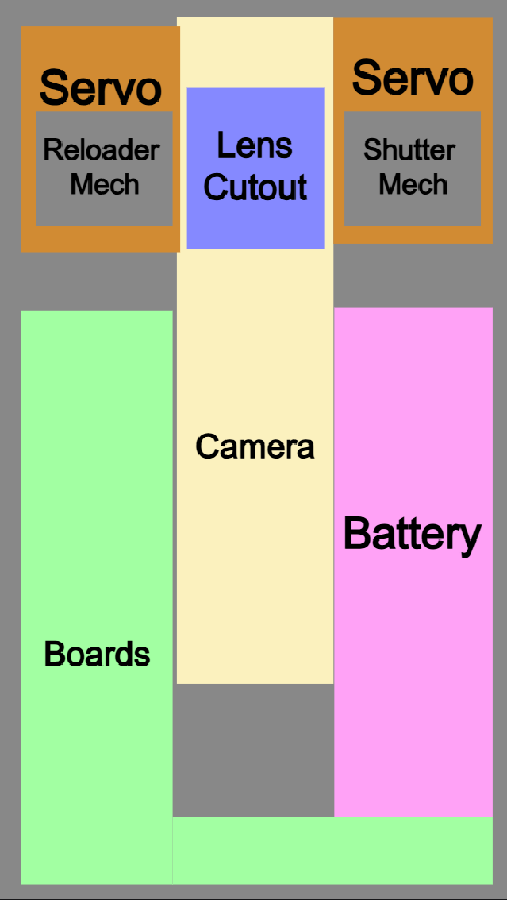
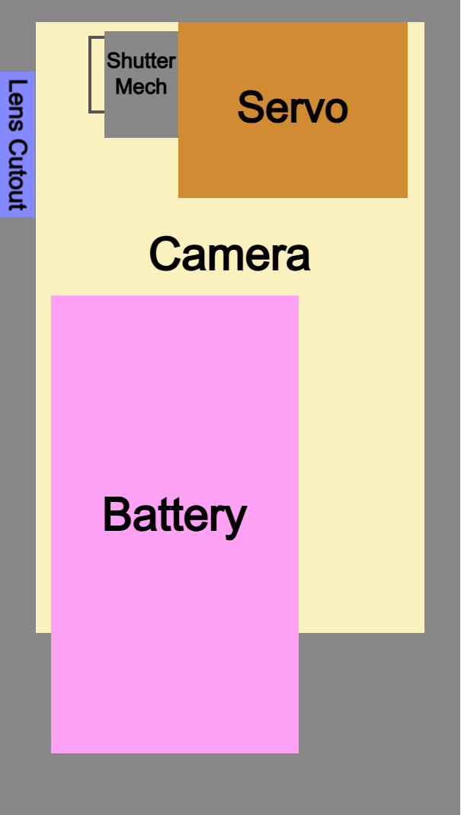
Design Diagrams
Left Center Right

Slide 18
Design Diagrams
Left Front Top
PCB EMPTY SPACE
Arms
Wire Gap
Top Plate
Top Plate
PCBs
Arms
Arms
GPS + Sensors + Cam
GPS + Sensors + Cam
MCU + Lora
MCU + Lora
`
Battery
Battery
PSU
PSU
PSU
PSU
Speaker Case
Speaker Case
Speakers
Speakers
Servo
Servo
Bloom Mechanism
Bloom Mechanism
PCB SHELL
Battery
Bottom Plate
Bottom Plate
Notes:
Nathan
NOTE we will not able to fit the battery
NOTES: work in progress for the battery placement, very difficult

Slide 19
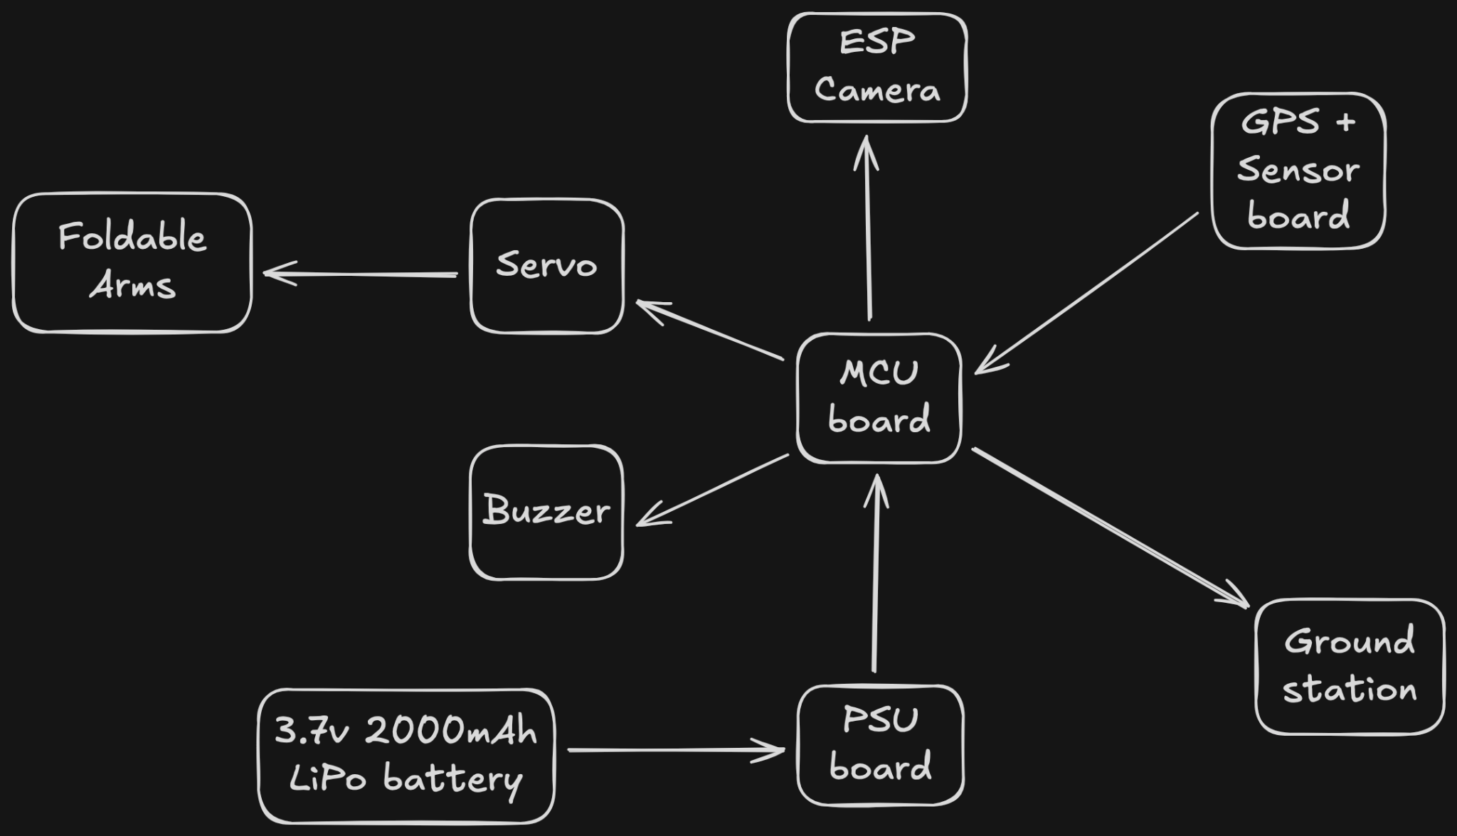
Electrical Subsystem
OVERVIEW
Notes:
Phoenix

Slide 20
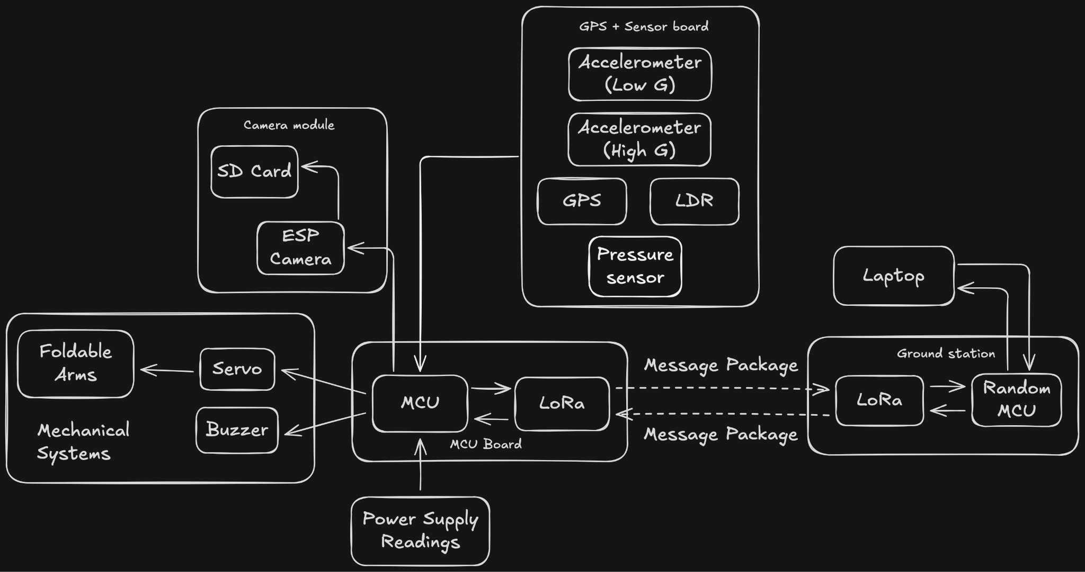
Electrical Subsystem
OPERATIONS
Notes:
Phoenix

Slide 21
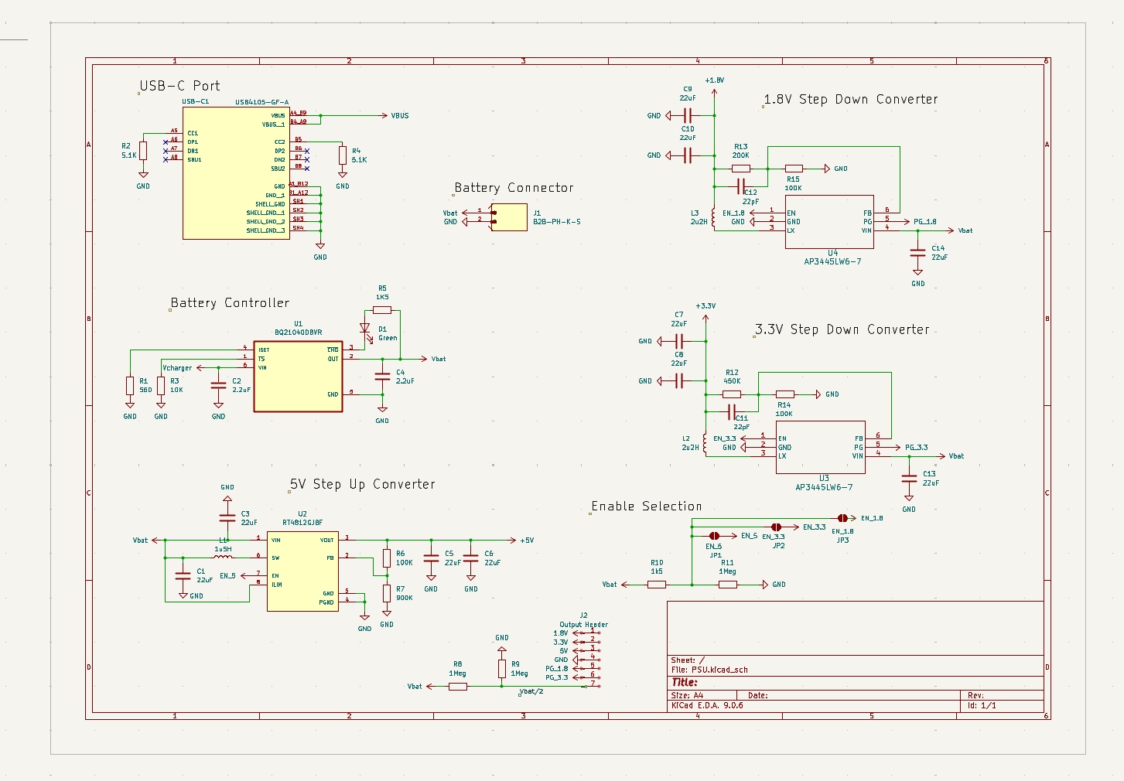

Slide 22
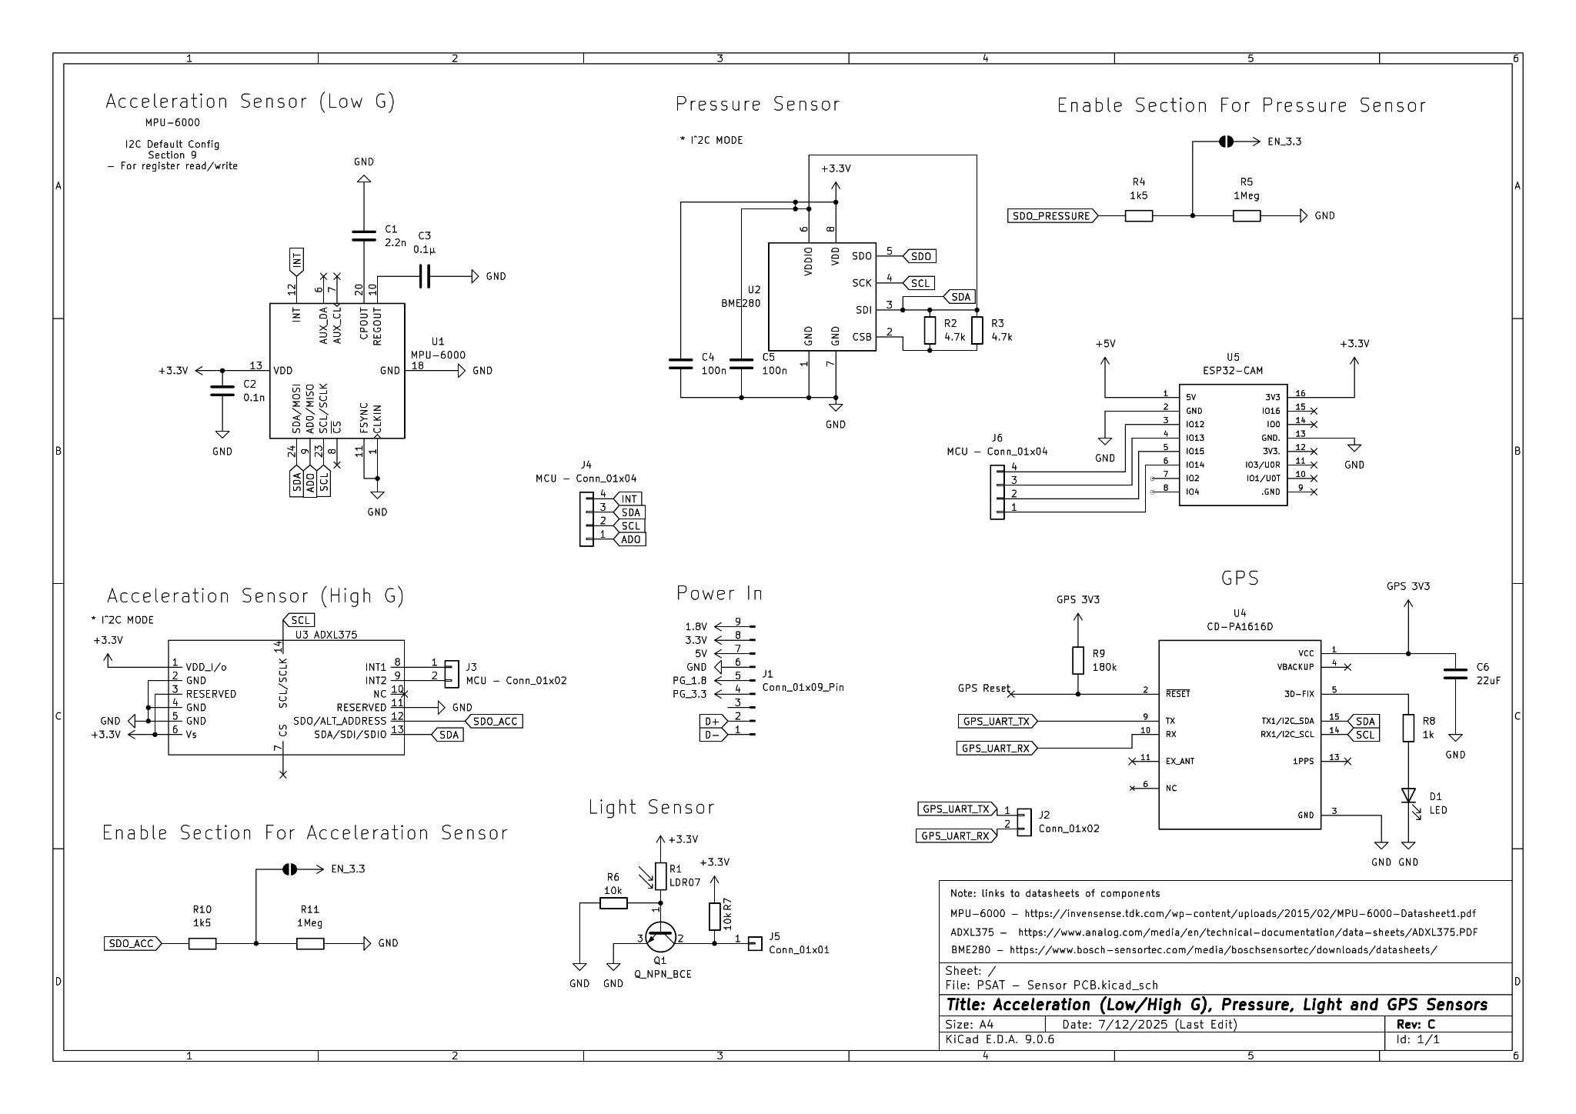

Slide 23
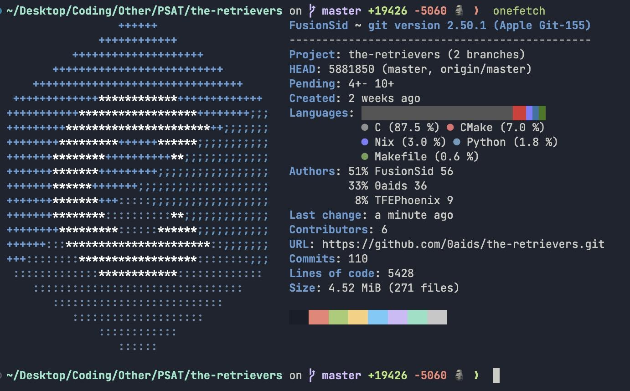
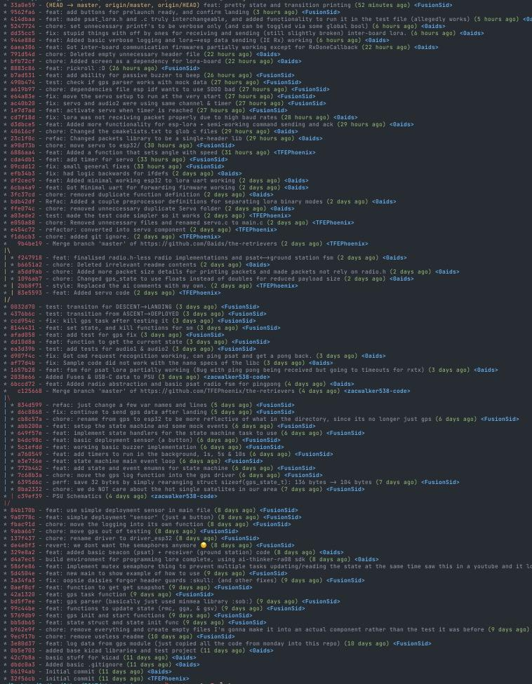
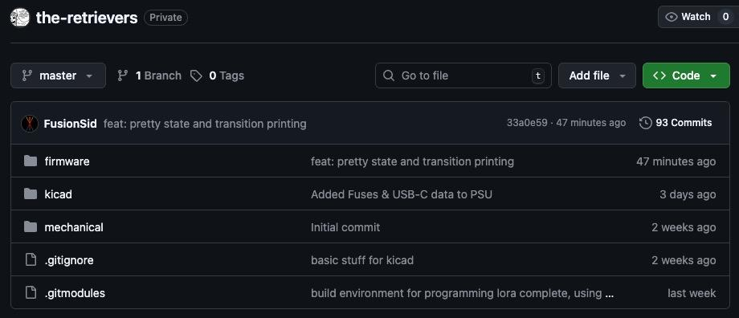
Version Control
SOFTWARE
Notes:
Siddhesh - GPS + actual finite state machine.

Slide 24
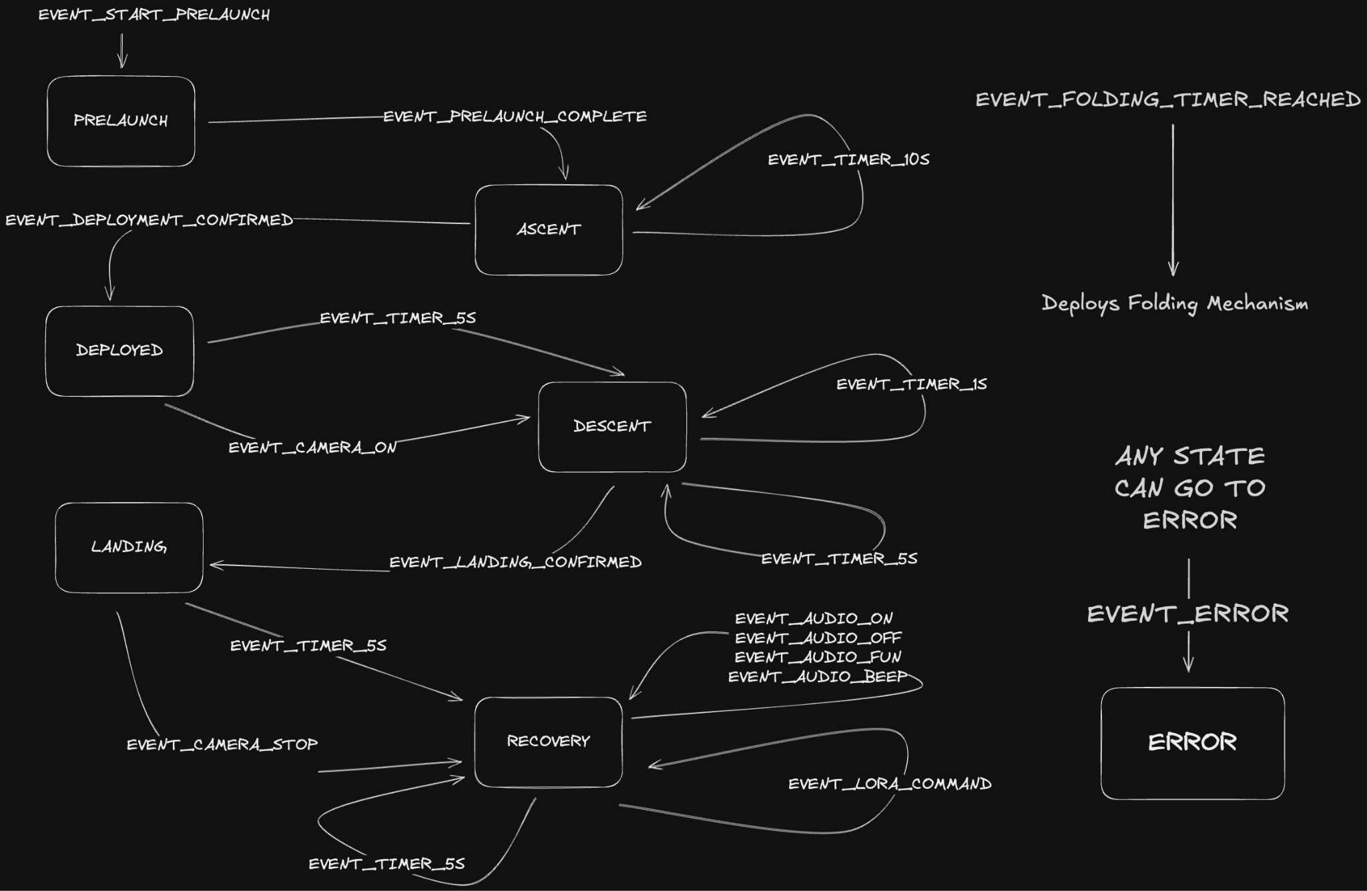
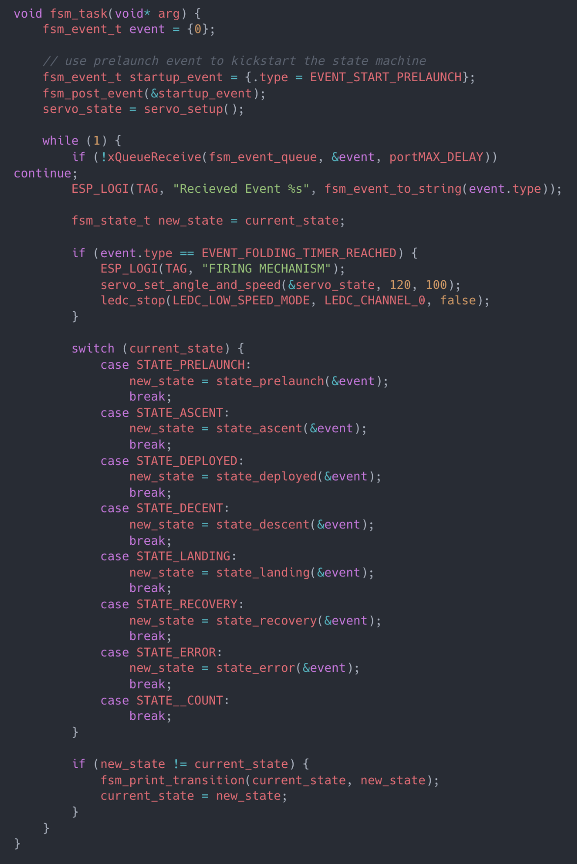
PSAT State Diagram
SOFTWARE
Notes:
Siddhesh - Main state diagram

Slide 25
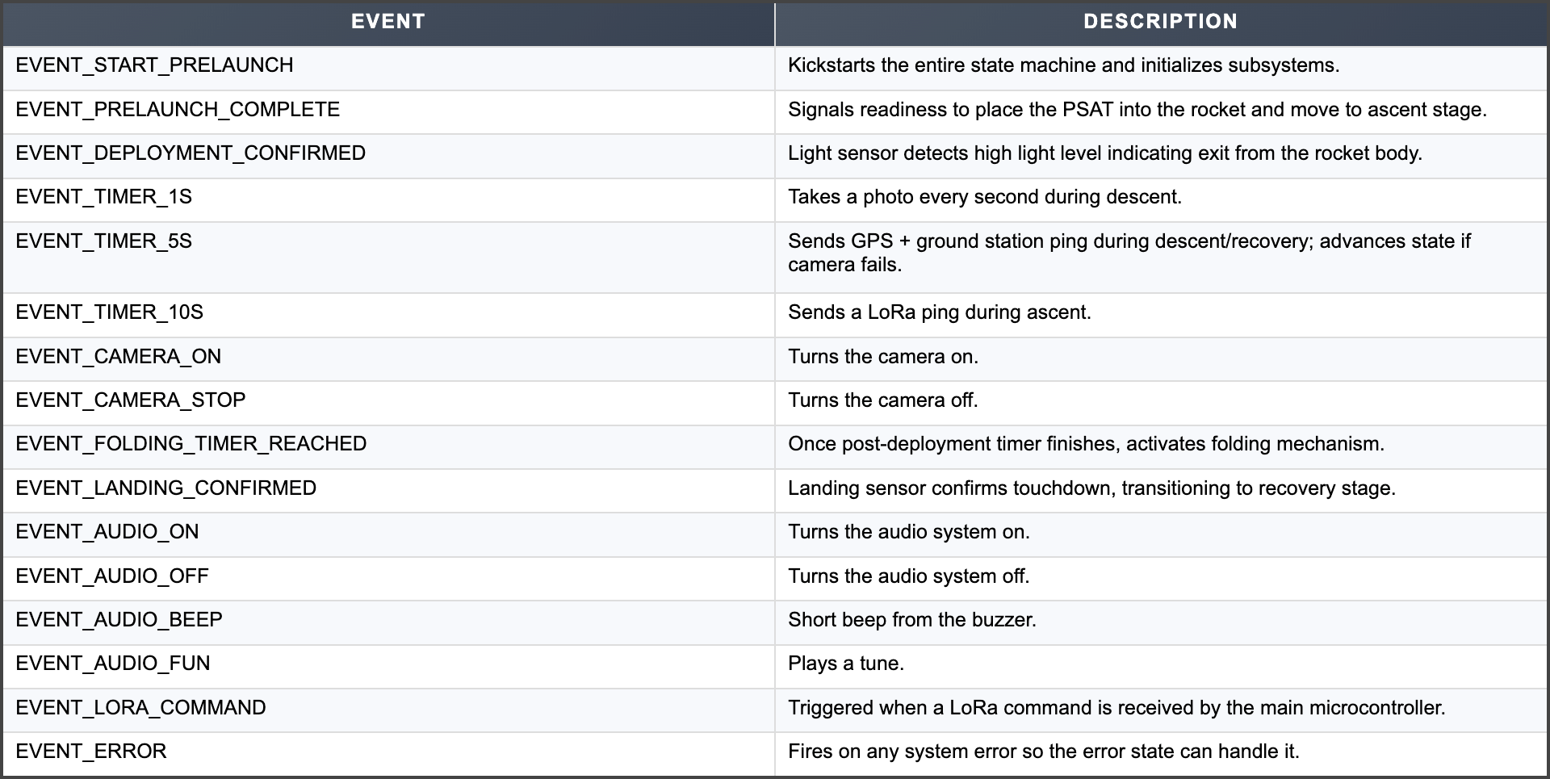
State Machine Events
SOFTWARE
Notes:
Siddhesh - Main state diagram

Slide 26
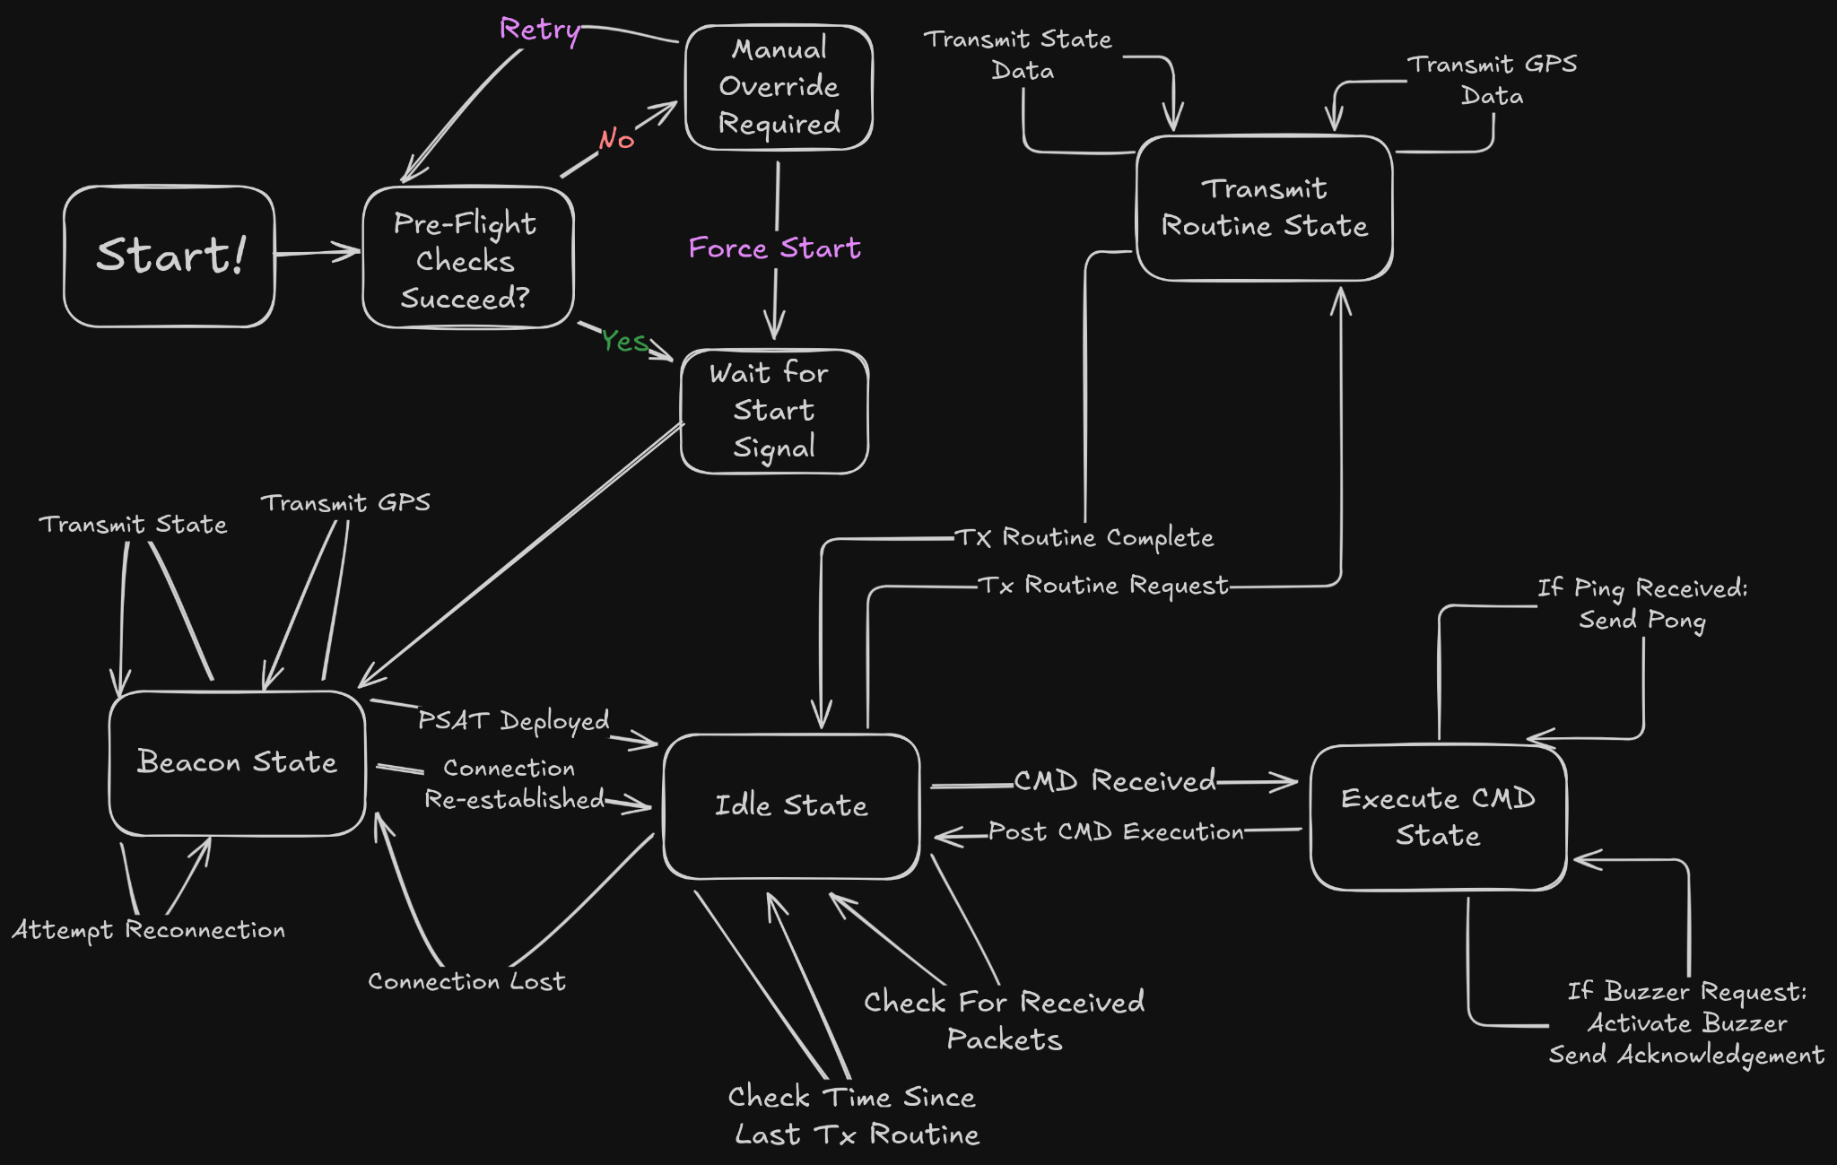
PSAT LoRa State Diagram
SOFTWARE
Notes:
Aidan - lora communications

Slide 27
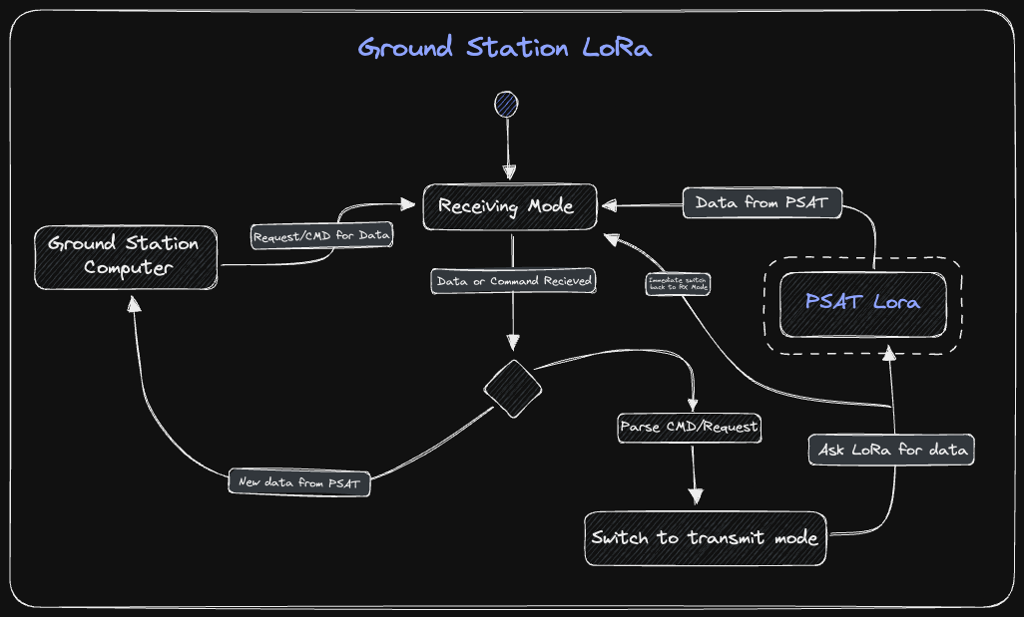
Ground Station Lora State Diagram
SOFTWARE
Notes:
Aidan - lora communications

Slide 28
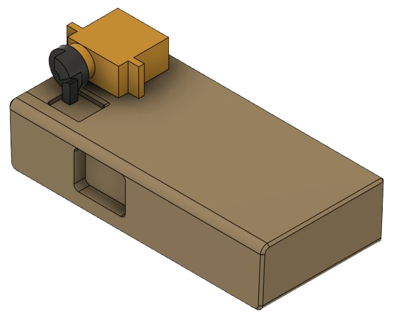
Mechanical Subsystem
SHUTTER
I-MG1
9 Gram Servo
Supplied
2x M2, 6mm Screws
I-MS3
I-MG3
Shutter Swing Arm
3D Printed
Used To Push Pusher Arm
Glued Onto Servo Arm
Pusher Arm
3D Printed
Pushes On Shutter Button
Glued Onto Shutter
Camera
Supplied
Notes:
Daniel

Slide 29
The Bloom Prototype

Slide 30
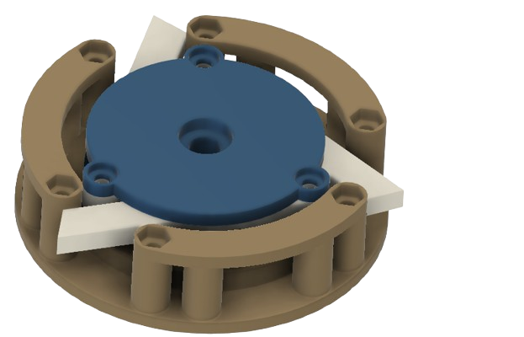
Mechanical Subsystem
Bloom Vs3
Top plate holds arms and allows for outwards rotation.
Bloom shells keeps arms in place with holes to allow extension.
Notes:
Daniel
SEE discord for more info

Slide 31
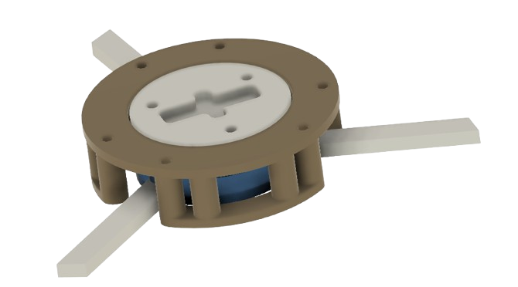
Mechanical Subsystem
Bloom Vs3
Servo attachment allows for servo integration
Arms are extended as they rotate
Notes:
Daniel
SEE discord for more info

Slide 32
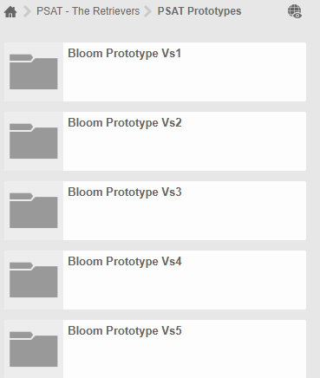
Bloom Iterations
Vs 1 - Tested Basic Motion.
Vs 2 - Added 3 arms and refined motion for maximum extension.
Vs 3 - Added servo attachment and refined joints.
Vs 4 - Added long arms and made to fit PSAT rods and plates.
Vs 5 - Added elastics.
Vs 6 (Work in progress) - Adds bearings to smooth joints and replaces elastics with torsion springs.
Notes:
Now show the iteration of prototypes that you’ve gone through

Slide 33
Demo Time!!!

Slide 34
The Umbrella Prototype

Slide 35
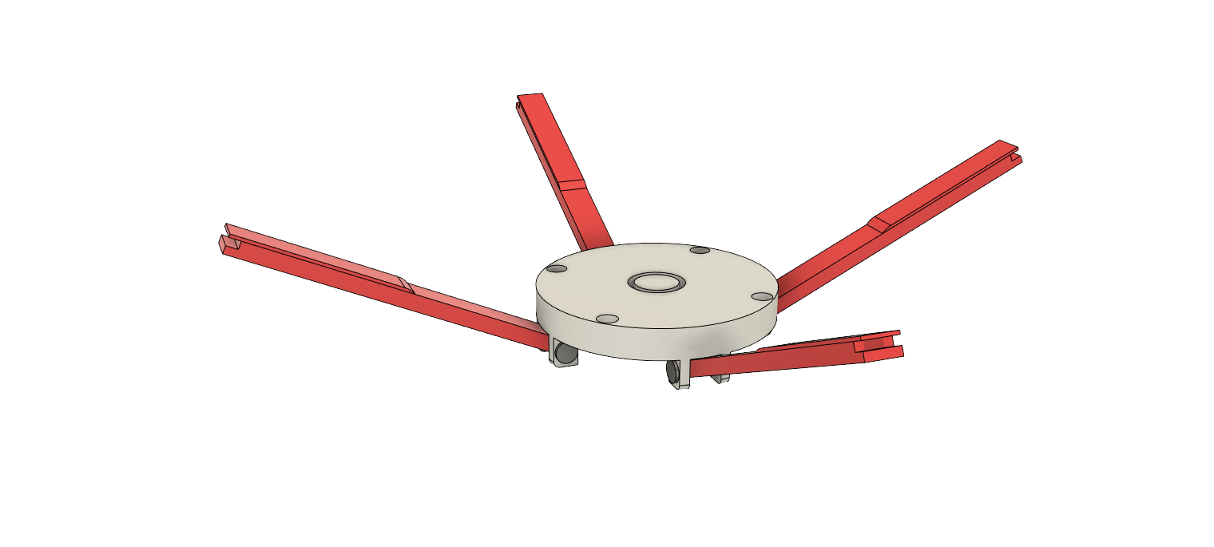
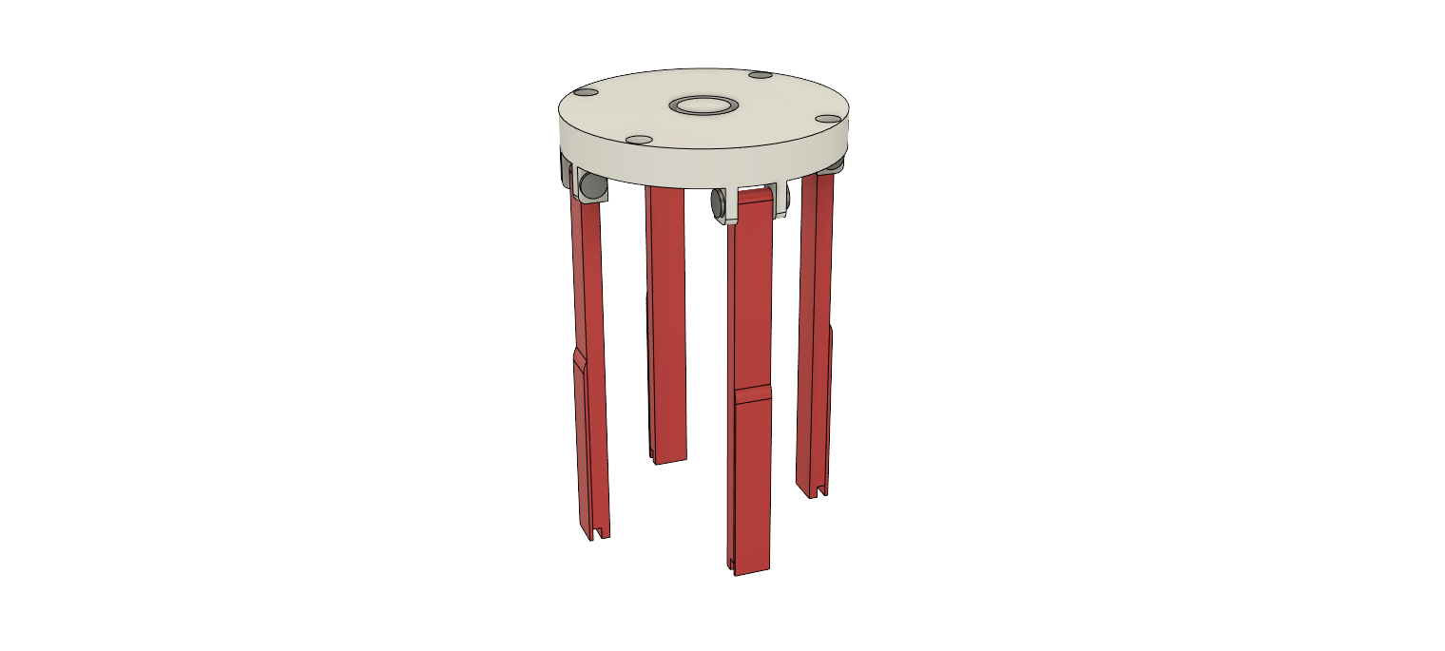
Mechanical Subsystem
Umbrella
Plastic Screw
Used to connect arms to joint
8mm long
Superglued in place to join (arm rotates freely
Expanding arms
3D printed
Rotates maximum 115 degrees
Joined by plastic screws and anchors
Notes:
Daniel

Slide 36
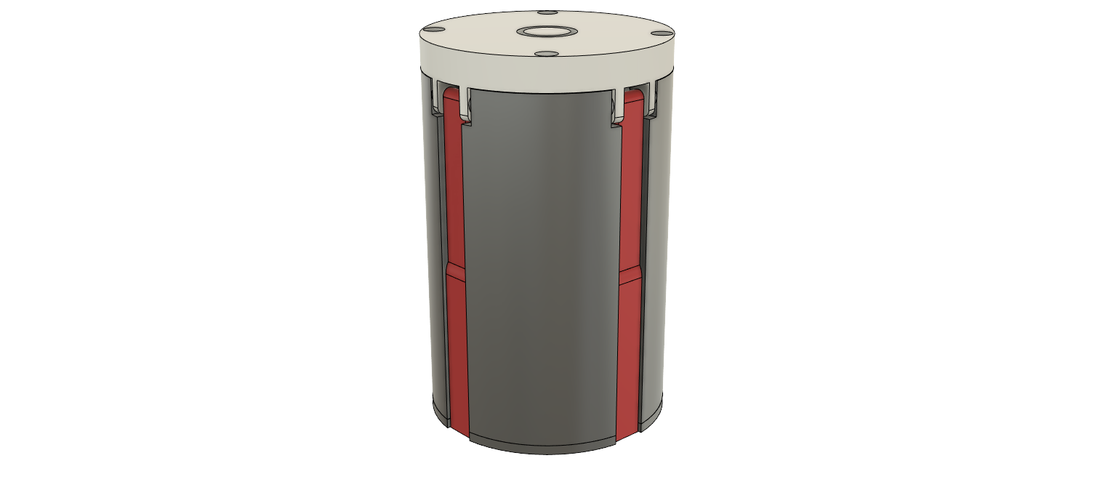
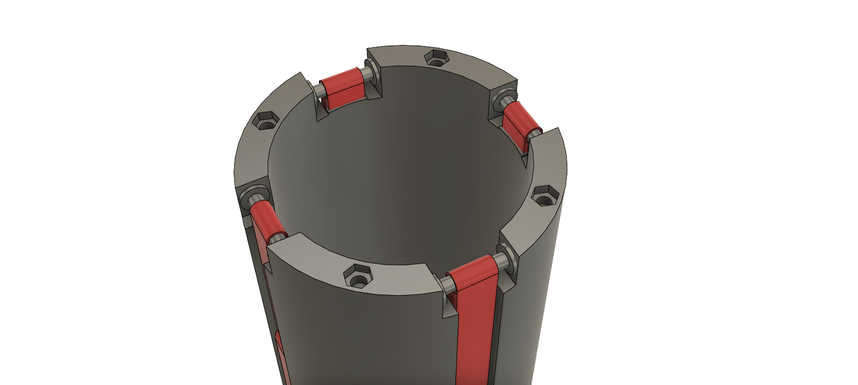
Mechanical Subsystem
Shell
Hex Nut
Used to connect top cap to shell
M3 Nut
15.7mm deep (for 12mm M3 screw)
Superglued to slot
Notes:
Daniel

Slide 37
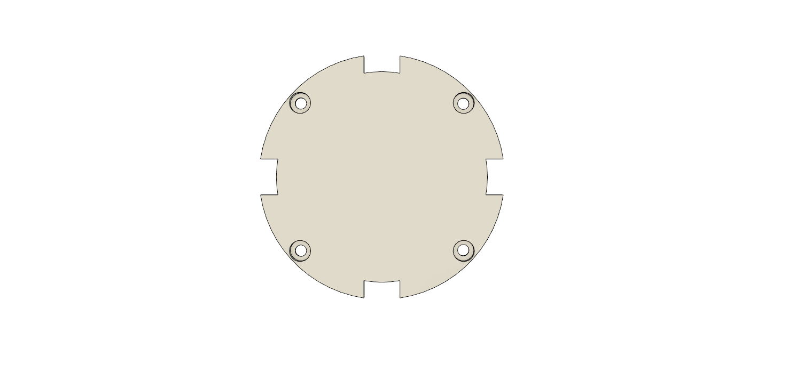
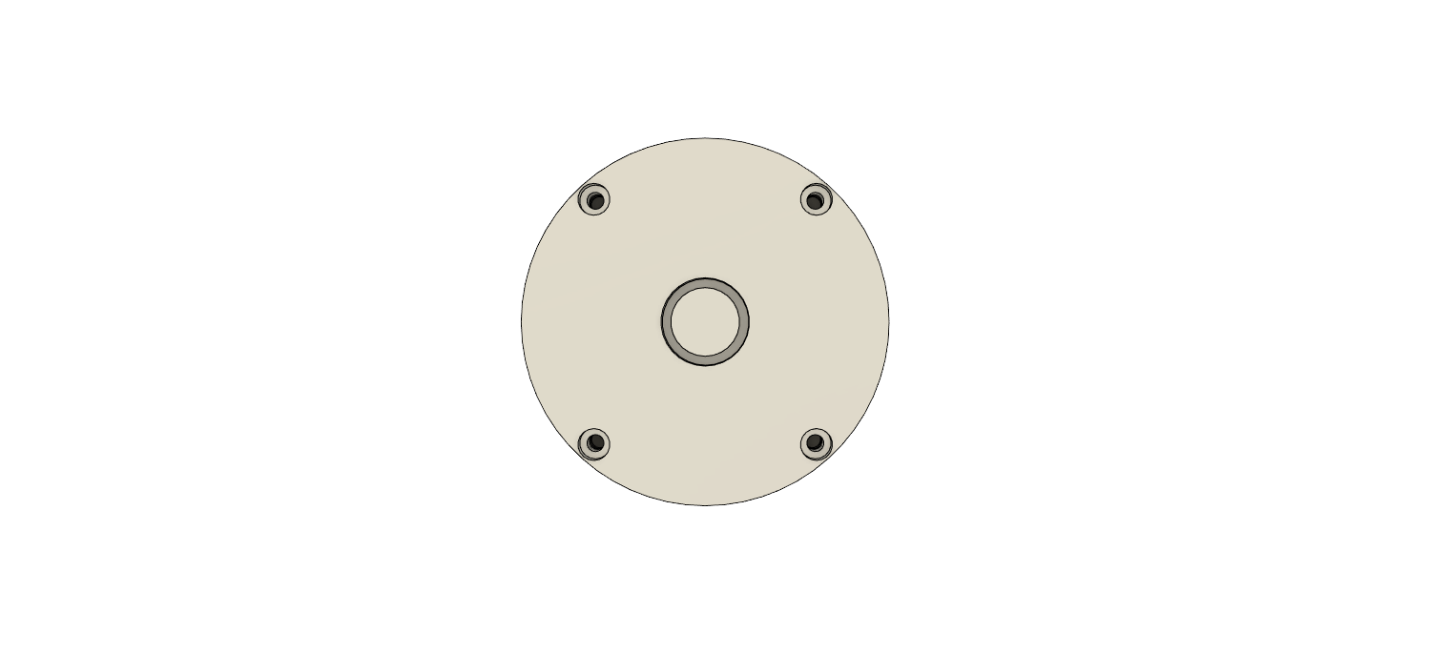
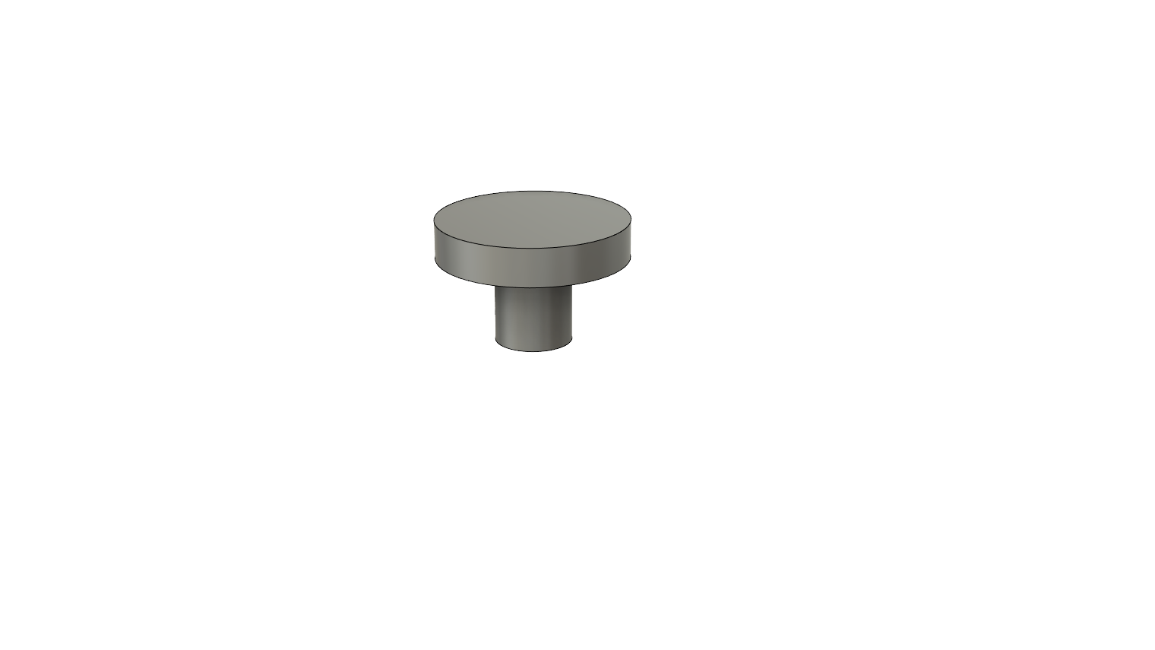
Mechanical Subsystem
Top/Bot Cap
Bottom
Top
Arm Slots
3D Printed
Used to hold arms
Screw Slot
M3 Flathead`
Mushroom Cap
3D Printed
Used to connect rubber bands to the arms
3D printed with top cap
Notes:
Daniel

Slide 38
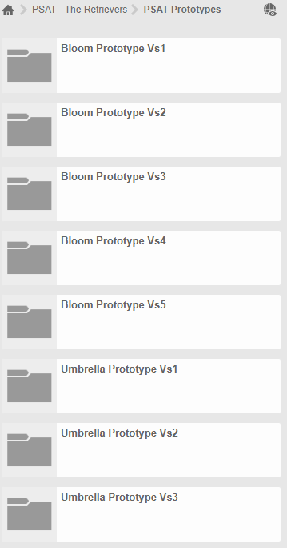
Umbrella Iterations
Vs 1 - Tested Basic Motion – Screws vs Plastic cap joints
Vs 2 - Optimised space and refined anchor joint
Vs 3 - Refined tolerances between components and modified arm component to fit within the rocket
Notes:
NOTE: Vs3 is just improvements to Vs2 such as separating the rubberband connection joint into multiple components

Slide 39
Demo Time!!!

Slide 40
The Final Solution

Slide 41
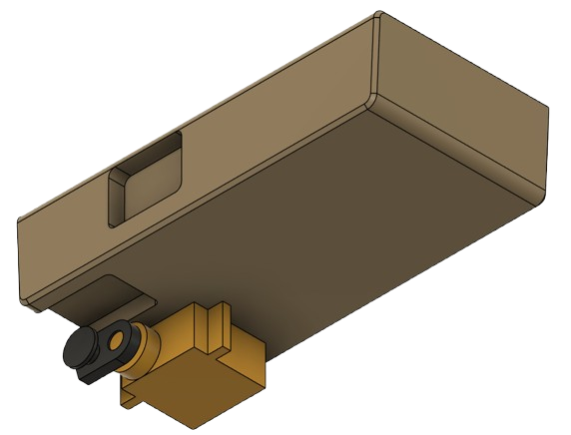
Mechanical Subsystem
RELOADER
Camera
Supplied
Reloader Swing Arm
3D Printed
Used To Pull Reloader Via Fishing Line
Camera Has Built In Spring For Return
Glued Onto Servo Arm
I-MS2
I-MG2
9 Gram Servo
Supplied
2x M2, 6mm Screws
Notes:
Daniel

Slide 42
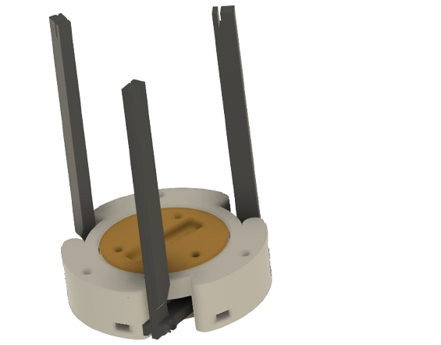
Mechanical Subsystem
Bloom+
Umbrella
Arms fit flush within body and deploy through servo rotation
Next Version will include bearings for joints.
All parts are 3D printed. Some will possibly be machined using aluminum to increase strength.
Servo Attachment plate
Joined using M3 * 12mm screws and nuts
Notes:
Daniel

Slide 43
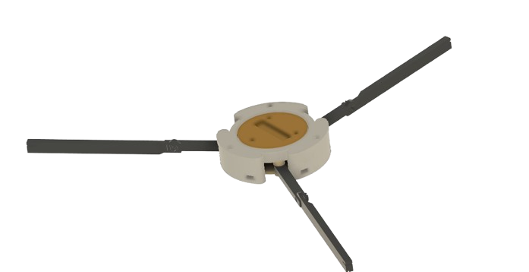
Mechanical Subsystem
Bloom+
Umbrella
Bloom Shell
Includes holes in walls to slide in through the M3 rods
Arms deployed by rotation.
Currently attached by M2 * 8mm screws. In next version attached with bearings 3x ⌀ 5 mm * 2.5 mm additionally.
Arms deployed elastically.
Current rubber band approach puts strain on the servo. Next version will fix this through the use of a 5mm OD torsion spring.
Rotation plate.
Holds arms. Joined to servo attachment using 3x M3 * 12mm screws and nuts. Arms are currently attached using 3x M3 * 12mm screws and nuts but in future will use 3x ⌀ 5 mm * 2.5 mm bearings as well.
Notes:
Daniel

Slide 44
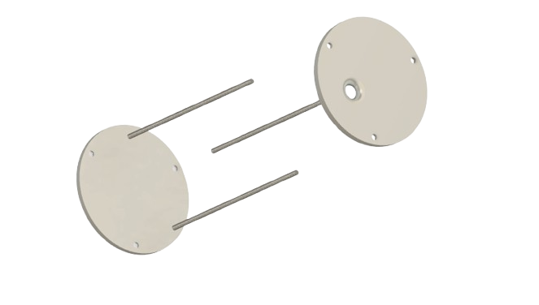
Mechanical Subsystem
Connection
M3 threaded rod joins plates and provides strength.
Joined by nuts at the ends
Top plate has holes for sensors
Bottom and top plates keep things in place.
This system construction allows for developing things separately as they can slide into system as modules.
Notes:
Nathan

Slide 45
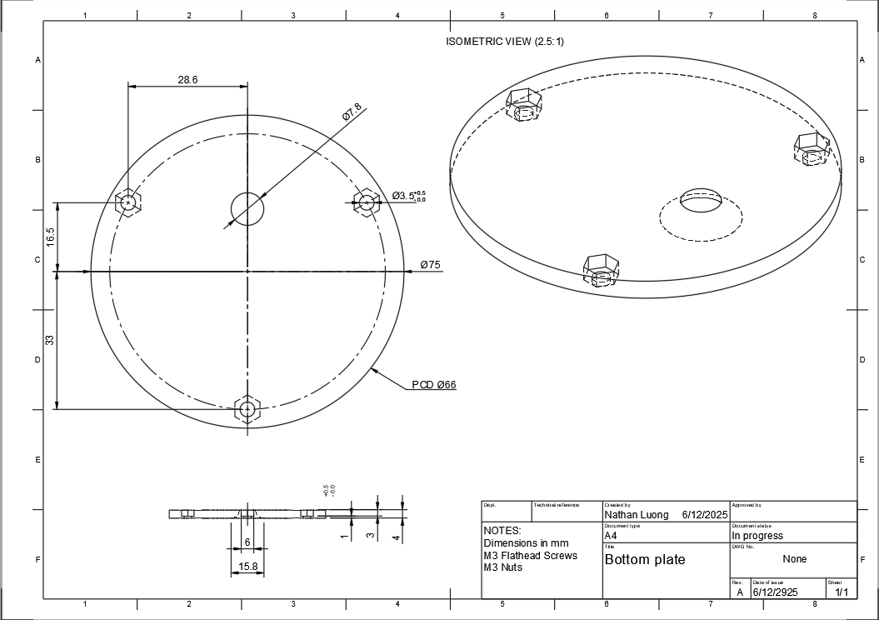
Technical Drawings
Top Plate
Notes:
Nathan

Slide 46
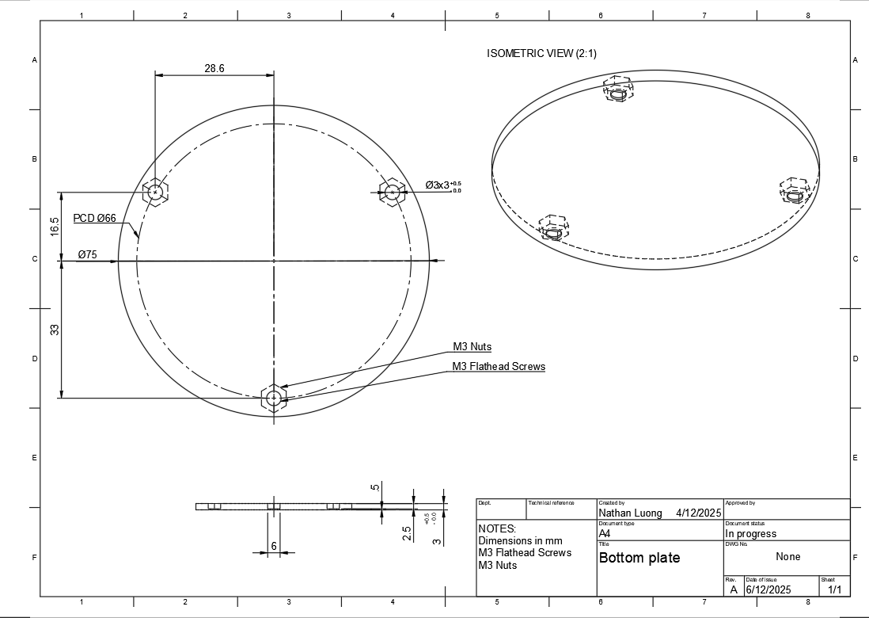
Technical Drawings
Bottom Plate
Notes:
NATHAN

Slide 47
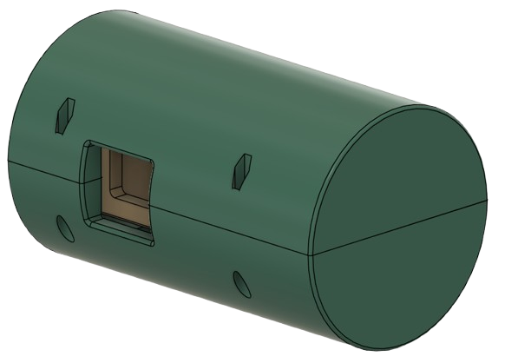
Mechanical Subsystem
BODY
Same On Rear
Hex Nut
M2.5
Sits In Hex Cavity
I-MS1
Screws
M2.5
Phillips
20mm long
Sits In Cylindrical Cavity
Shells
3D Printed
Notes:
Daniel

Slide 48
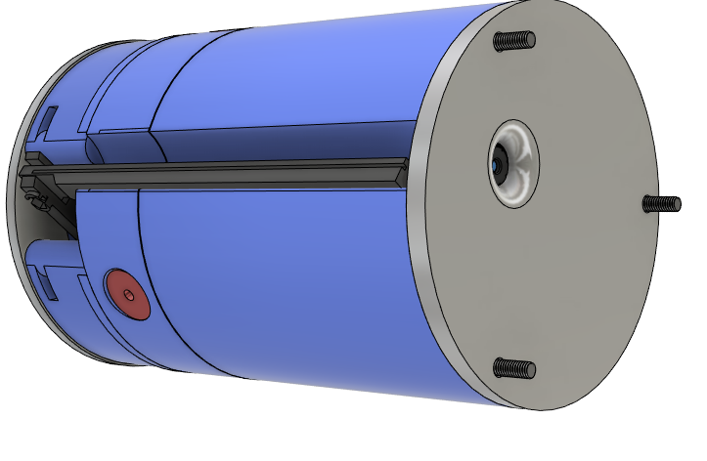
FINAL Mechanical Subsystem
SHELL
Hex Nut
M3
Sits Inside Top/Bottom Plate
Bottom Plate
Aluminium CNC
Top Plate
Aluminium CNC
Threaded Rod
M3
120mm
Sits Inside Top Plate
Blooming Mechanism
3D Printed
Notes: Extruding threaded rod due to adding extra clearance for future implementations
Speaker Casing + Mounting
3D Printed
Flush Speaker slot fit
PCB Casing
3D Printed
54.5mm diameter spacing for PCB
Notes:
Nathan “I’ll do this daniel since I need to complete the shell first”
NOTE: This is the final shell for the bloom prototype that we said we will move on with just for the pdr

Slide 49

SECTION VIEW

Slide 50
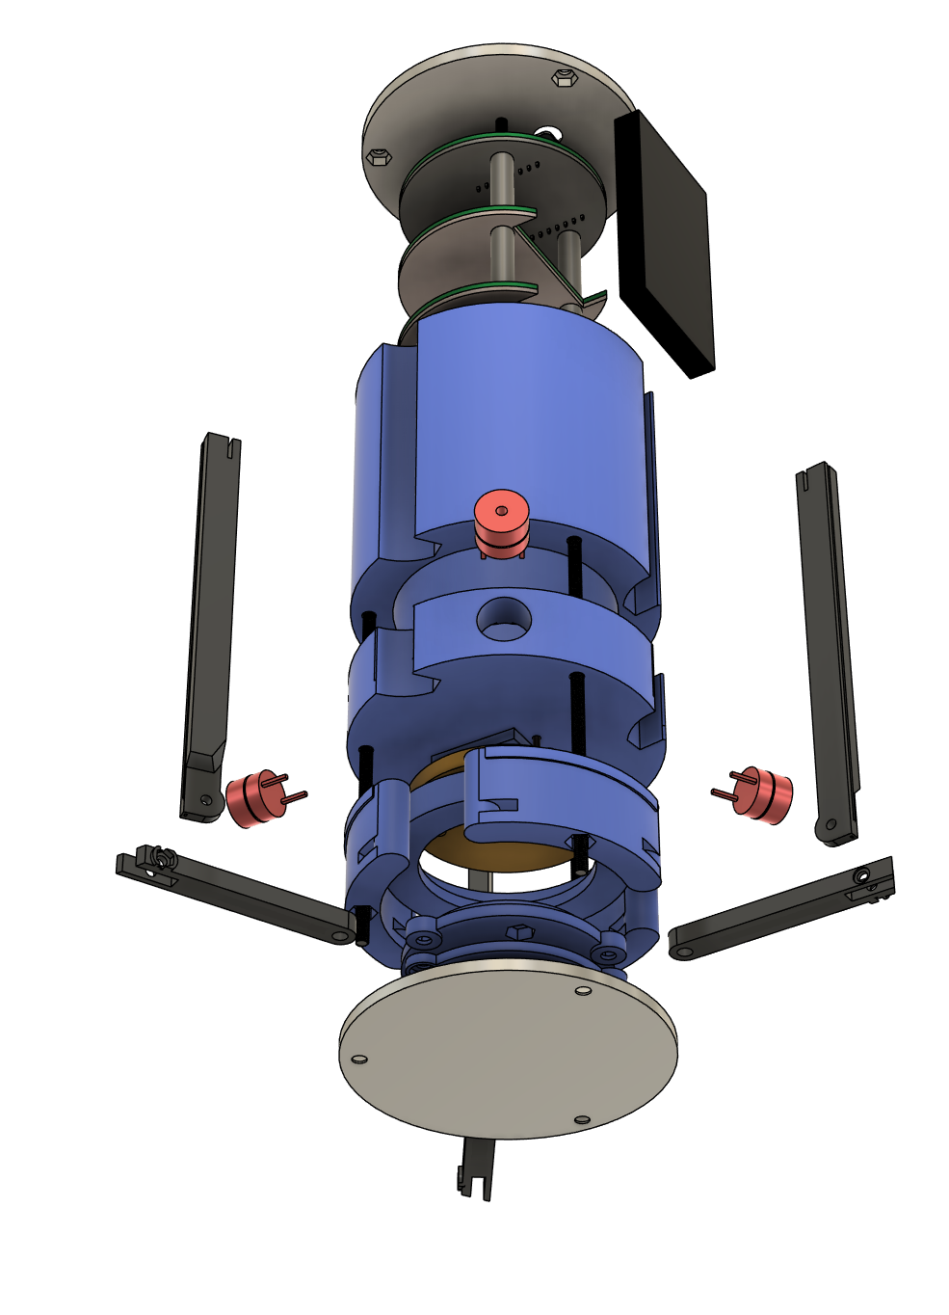
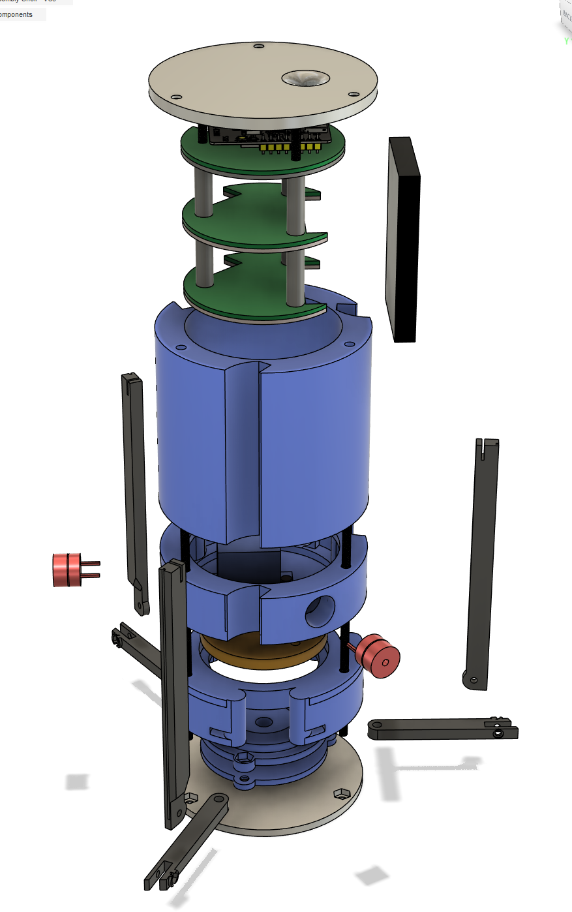
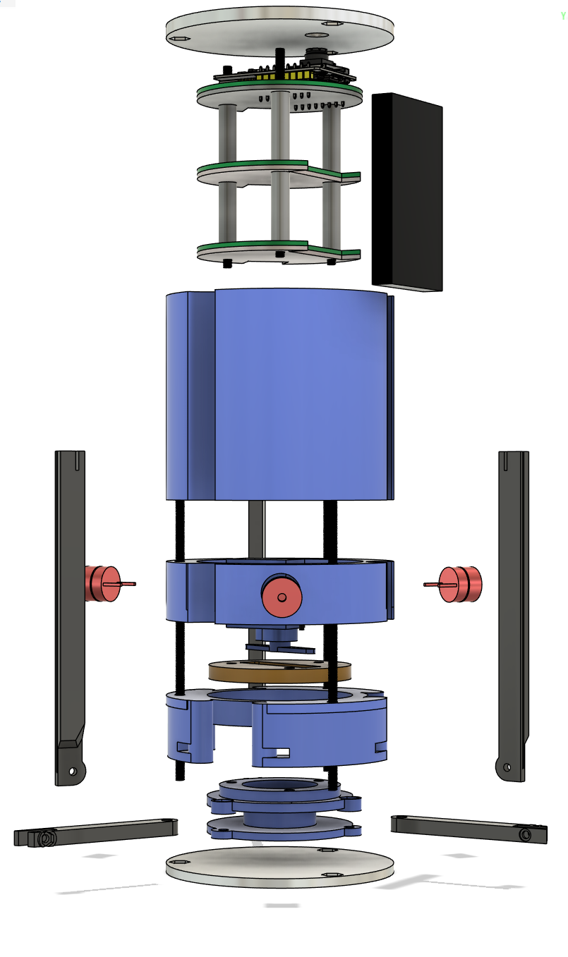
EXPLODED VIEW
EXPLODED VIEW
Notes:
Nathan

Slide 51
EXPLODED VIEW
TO BE ADDED, do not delete this slide

Slide 52
Prototype + Main Electronics Budgeting
BUDGET
Part NO | Part Quantity | Part Purpose | Part Price
ESP32-S3-Wroom Lora126X-CX ESPCAM | 1+ 1+ 1+ | Main MCU LoRa Camera | 10 NZD 10 NZD 20 NZD
BQ21040DBVR RT4812GJ8F AP3445LW6-7 12402012E212A | 1+ 1+ 2+ 2+ | PSU Battery Controller 5V Step up 3.3V + 1.8V Step down USB-C Receptacle (16+8 Dummy) | 0.50 NZD 2 NZD 0.50 NZD 0.70 NZD
ADXL375 BME280 CD-PA1616D Light sensor (Already have) | 1+ 1+ 1+ | Accelerometer (High G) Pressure sensor GPS Light sensor | 10 NZD 10 NZD 60 NZD
Notes:
Daniel
Honestly I have no clue where to begin here. We don’t really have a good list of parts
The list of parts is from the kicad. We need to generate a BOM (Bill of materials). And then for each part we need to get the quantity, price and no.
We do not have a concrete idea of all the parts we are using atm.
I’ll link a sheet here soon.

Slide 53
Prototype + Main Electronics Budgeting
BUDGET
Prototype Name/Number | Print Quantity/Filament used | Print Purpose | Print Time | Part Price
Umbrella Prototype Vs1 | 91.35g | Testing simple functions | 2h46m | $1.83
Umbrella Prototype Vs2 | 122.32g | Testing connection joint + improved mechanism | 3h44m | ~$2.60
Bloom Prototype Vs1 | 27 g | Basic Motion | 50m | $0.2
Bloom Prototype Vs2 | Not printed. 3D printer was not working. | Refine Basic Motion | NA | $0
Bloom Prototype Vs3 | 47.8 g | Servo attachment and refining joints | 1h56m | $1.2
Bloom Prototype Vs4 | 51.4 | Combining prototypes | 2h10m | $1.3
Notes:
Daniel
Honestly I have no clue where to begin here. We don’t really have a good list of parts
The list of parts is from the kicad. We need to generate a BOM (Bill of materials). And then for each part we need to get the quantity, price and no.
We do not have a concrete idea of all the parts we are using atm.
I’ll link a sheet here soon.

Slide 54
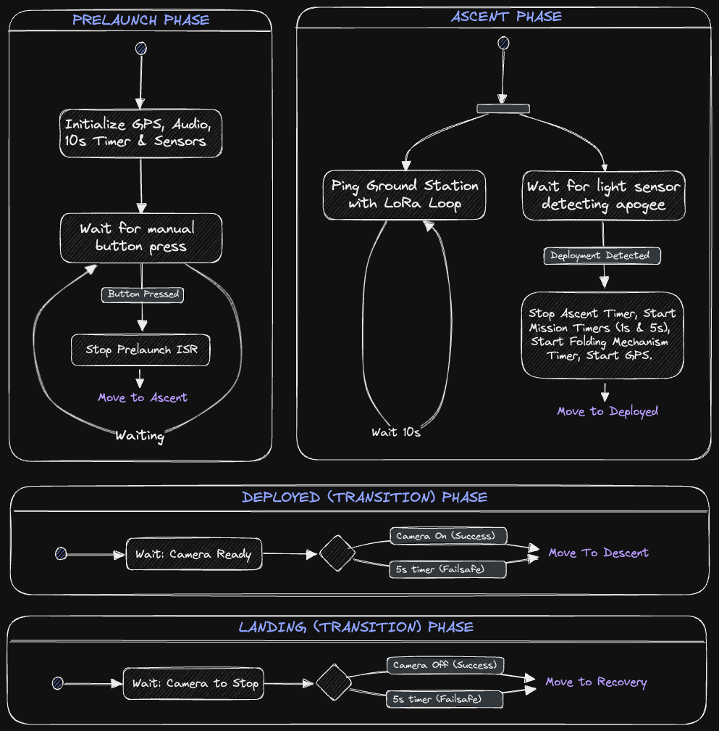
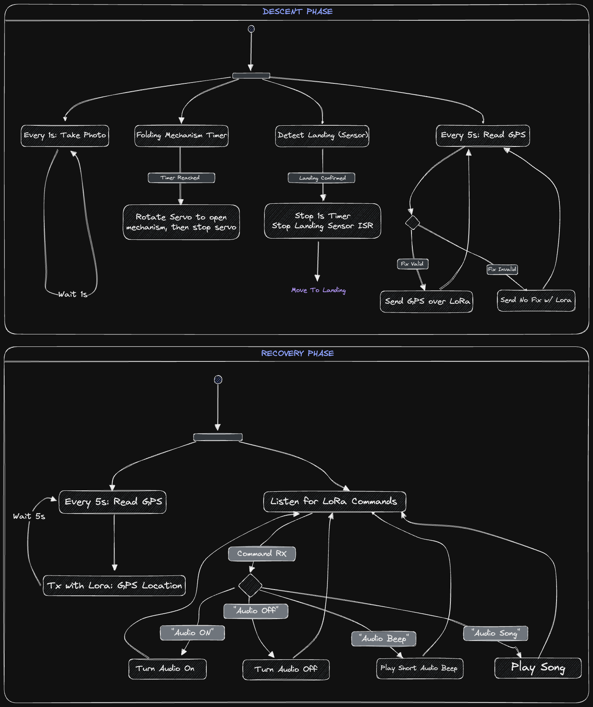
Concept Of Operations
Notes:
Siddhesh + Aidan

Slide 55
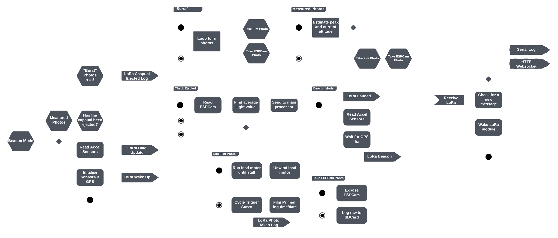
Concept Of Operations
Notes:
Siddhesh + Aidan

Slide 56
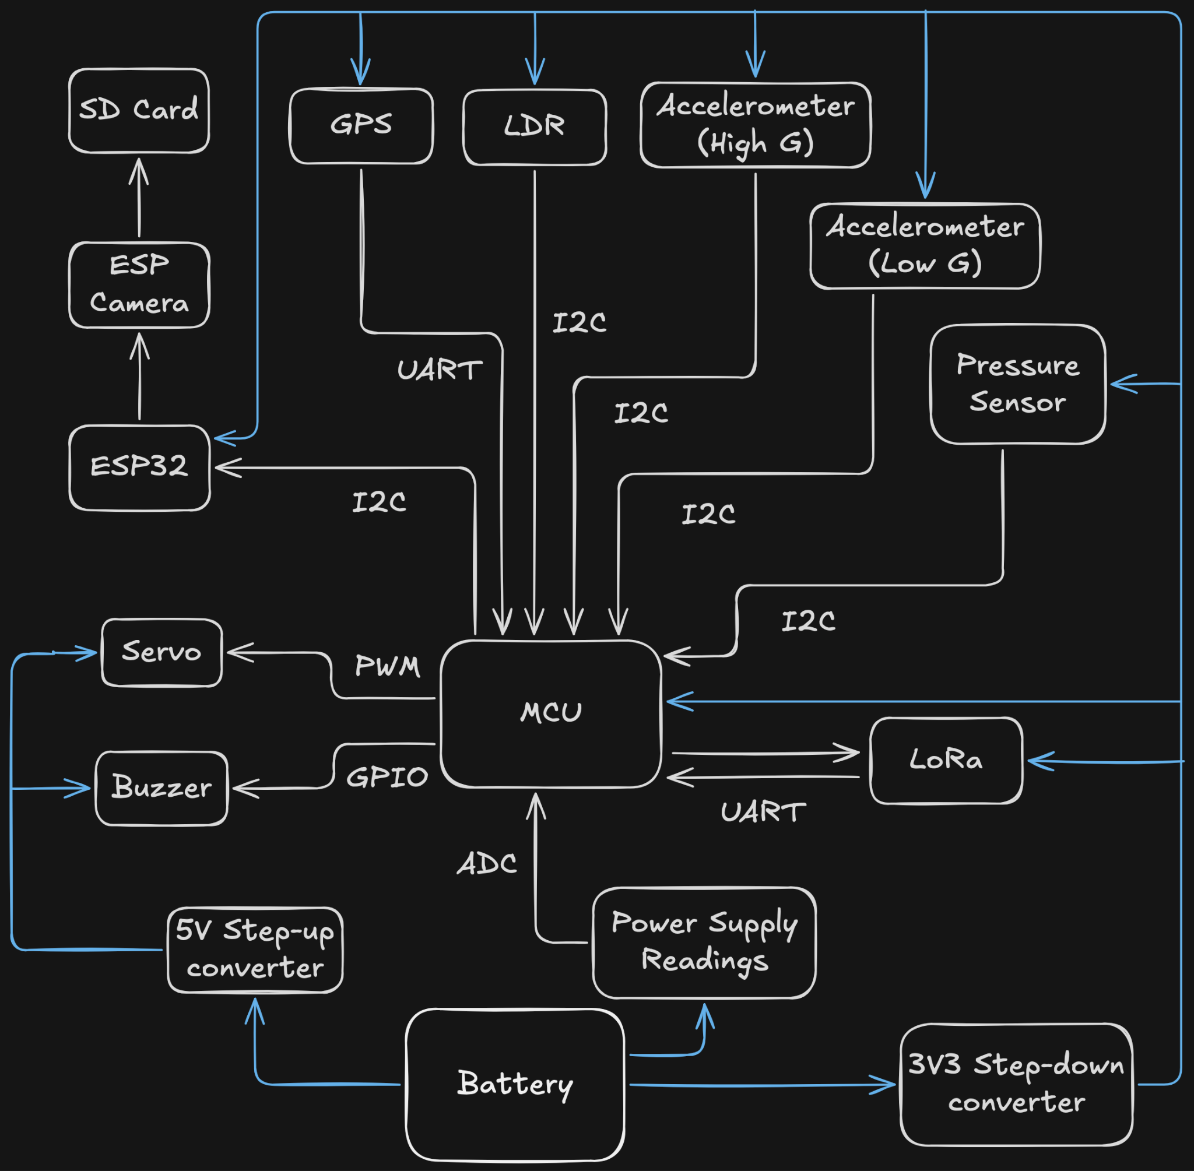
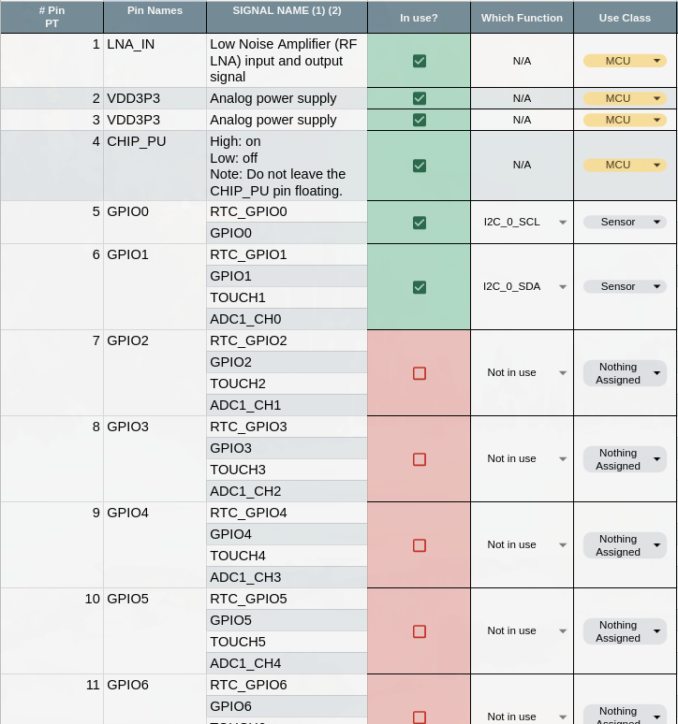
Interface Definitions - Electrical
PIN DEFINITIONS

Slide 57
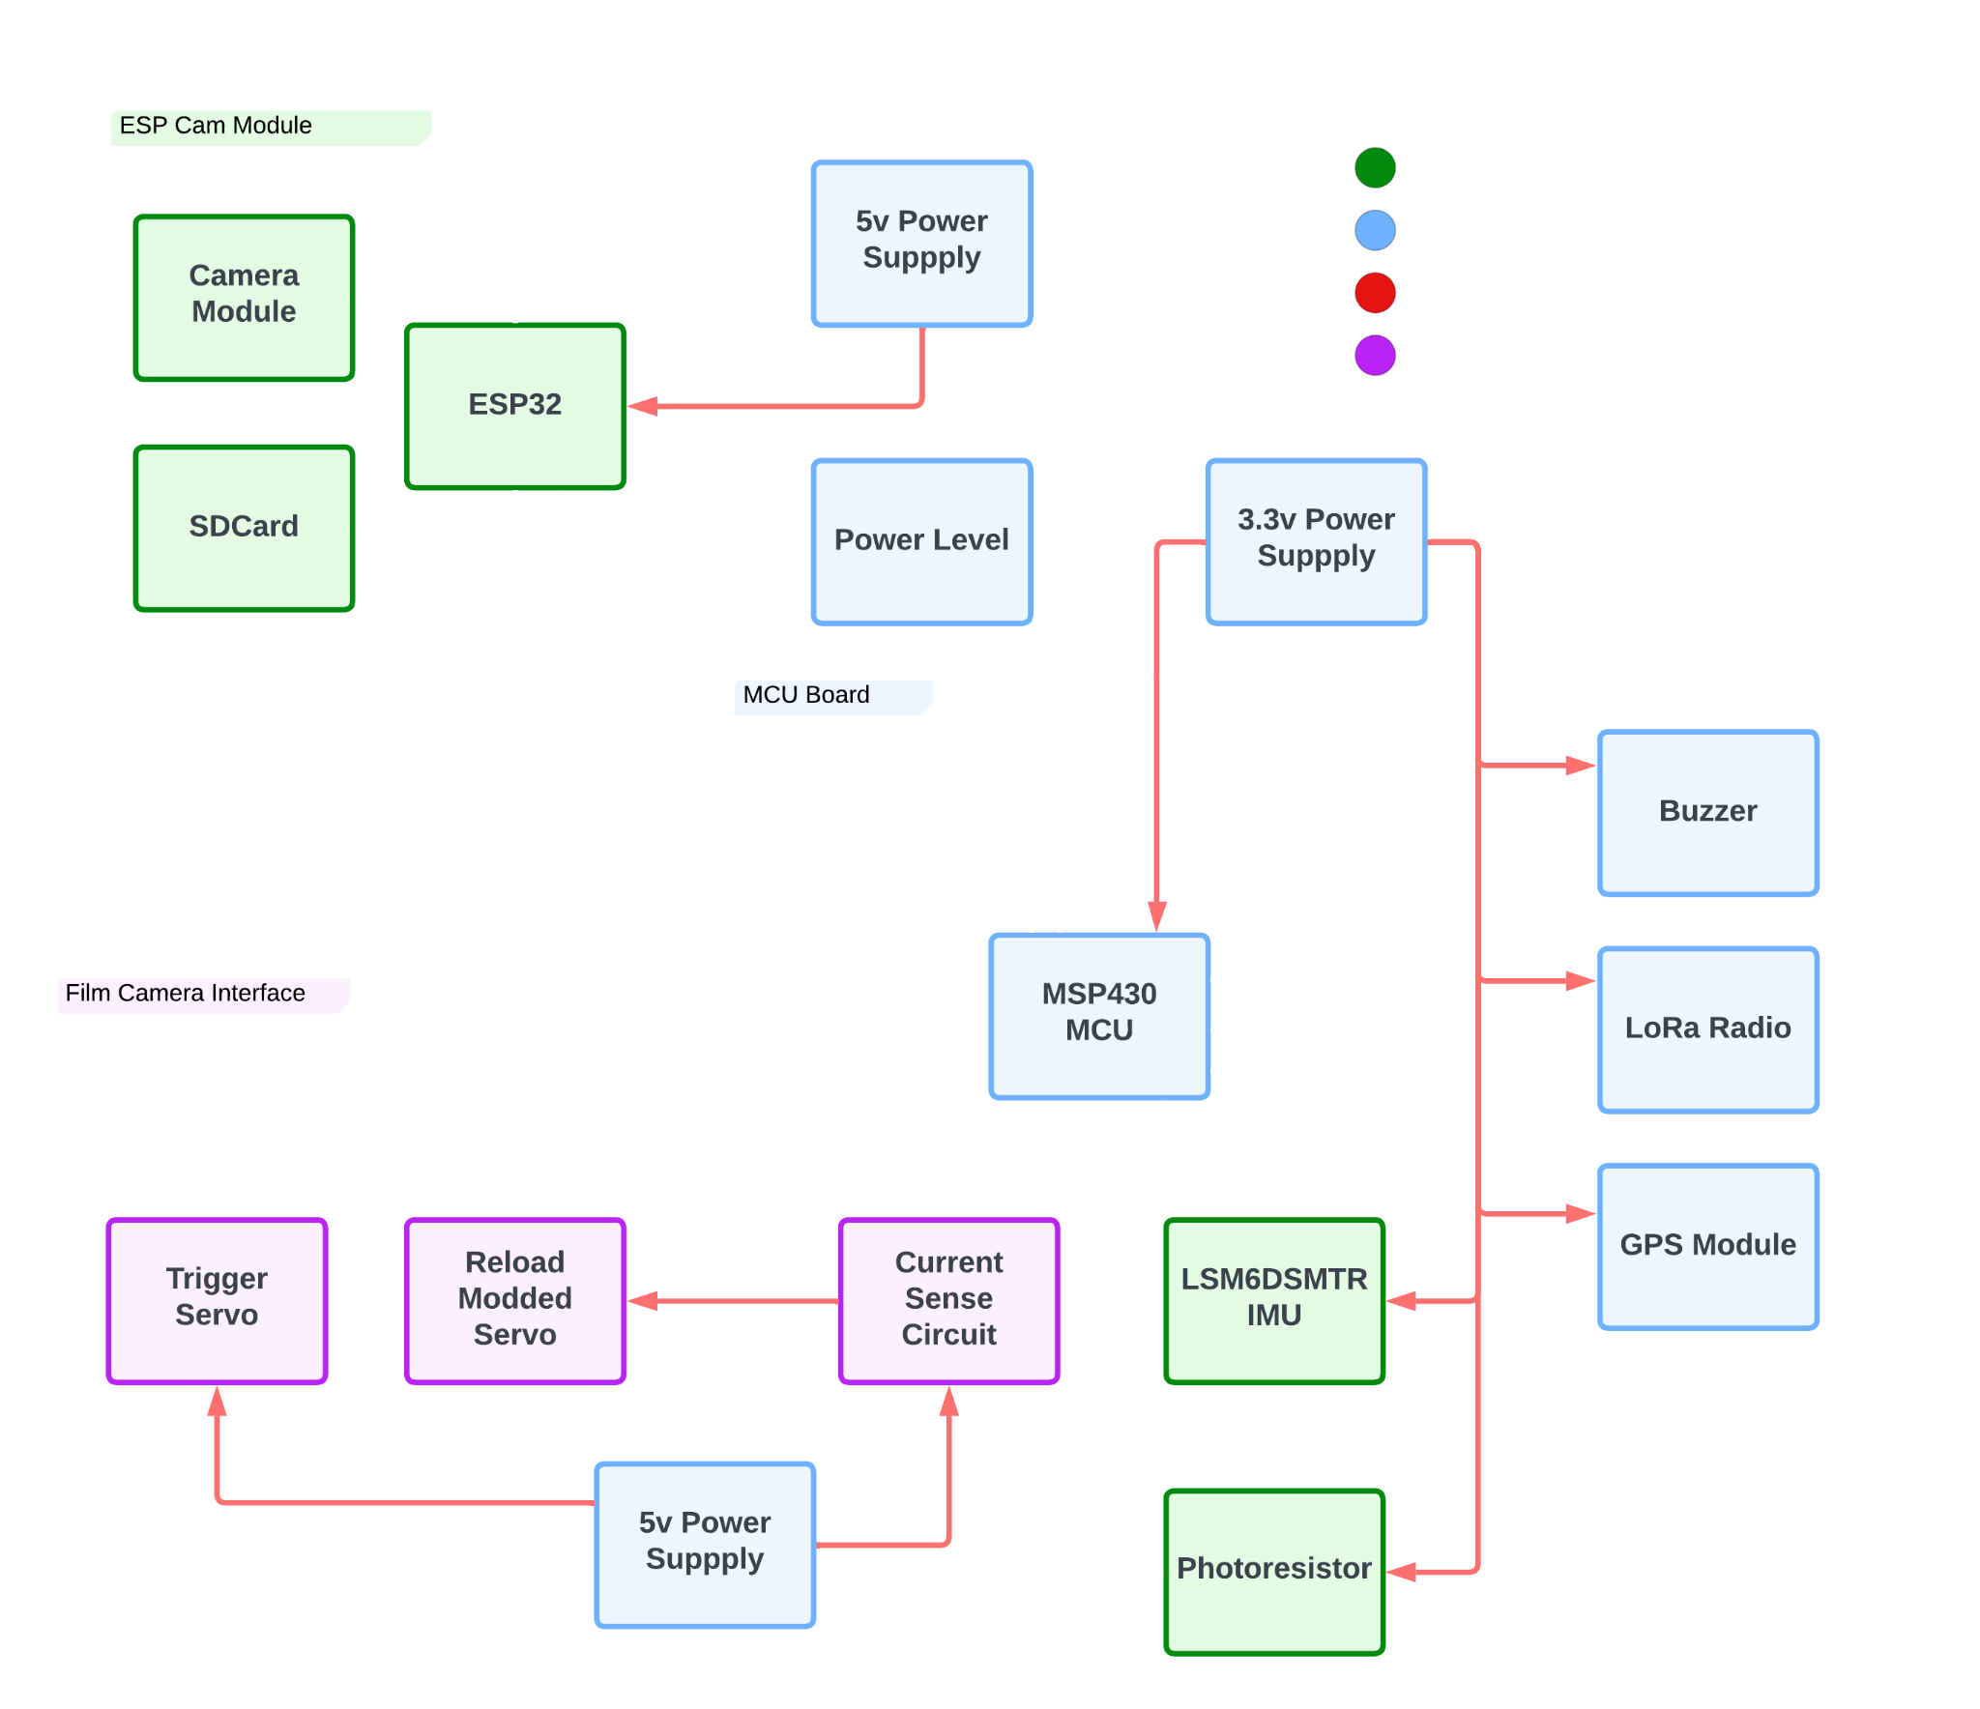
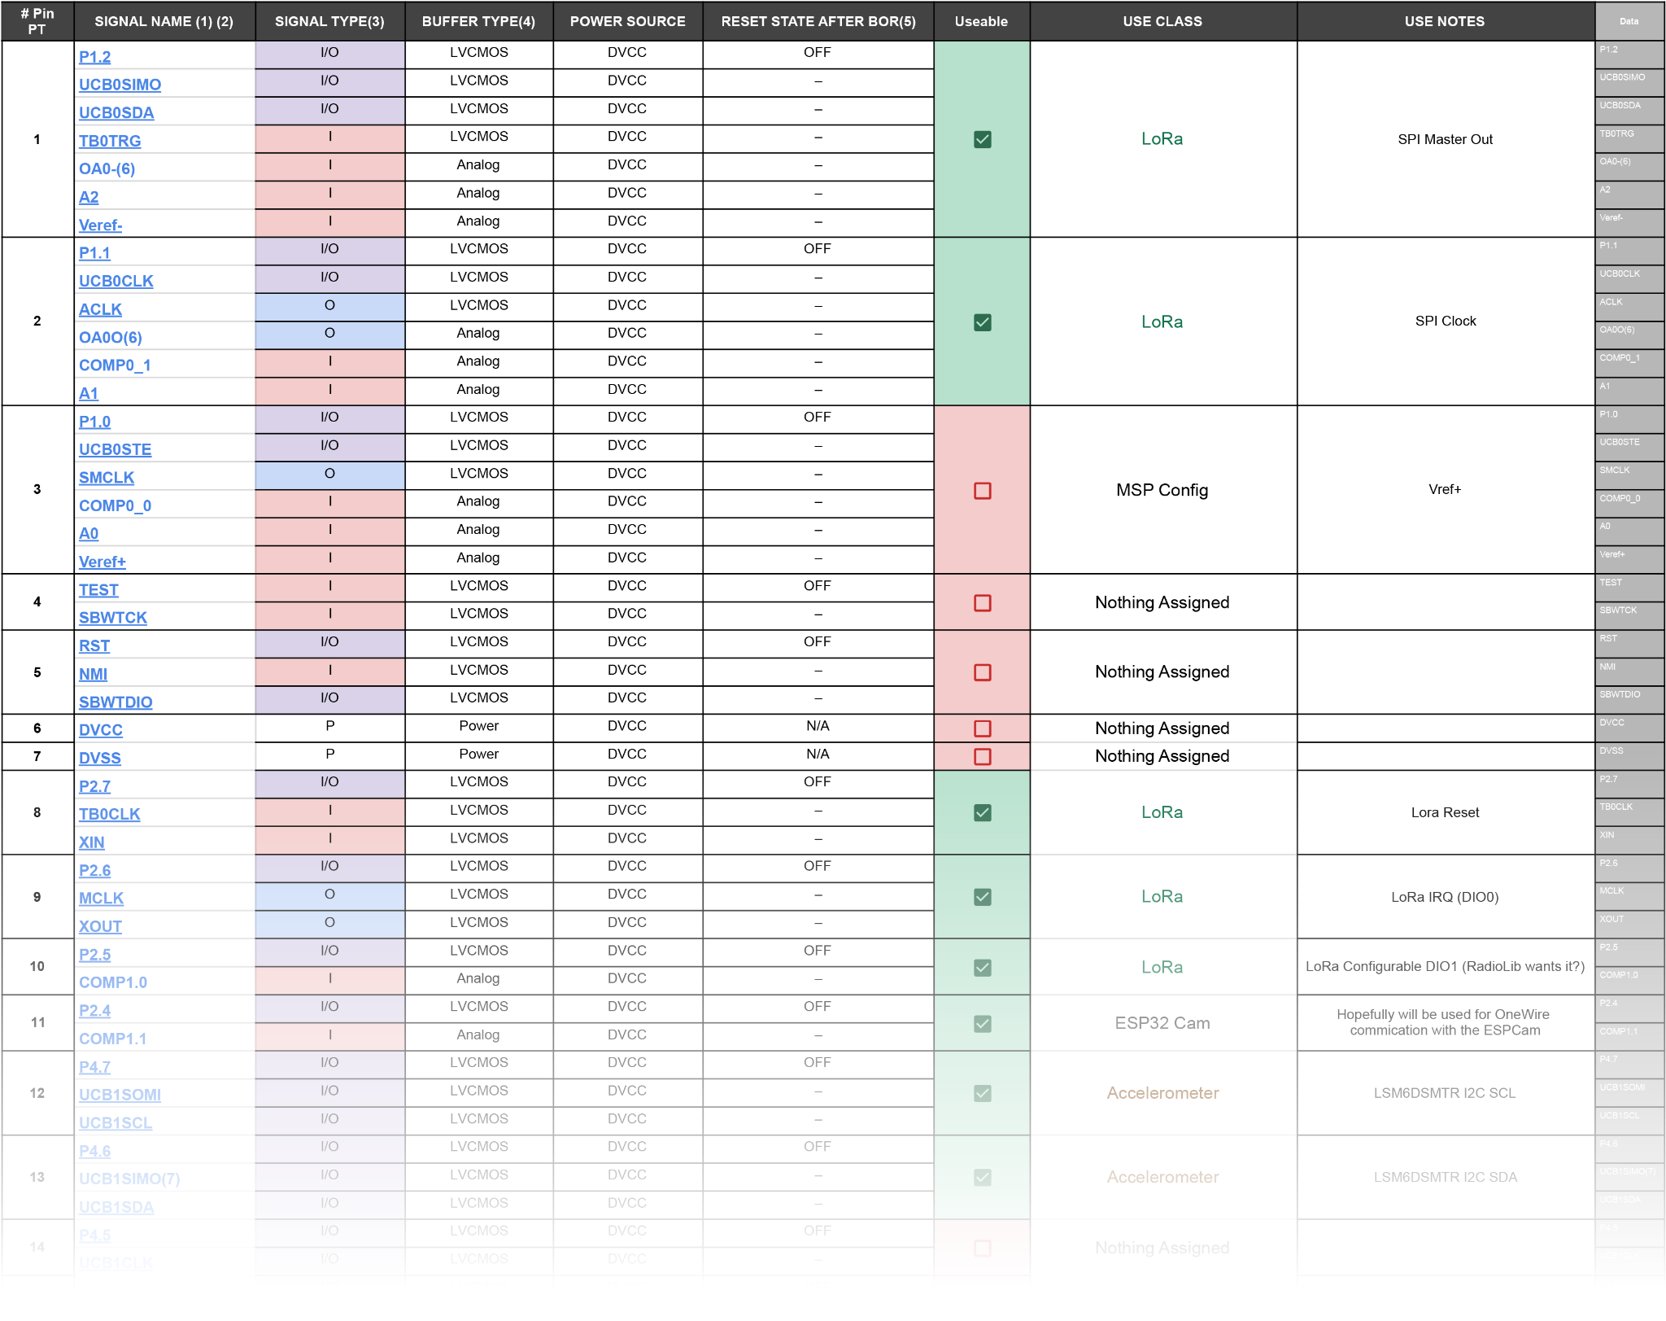
Interface Definitions - Electrical
MSP Pin Definitions
Notes:
https://docs.google.com/spreadsheets/d/1KJCRjE0mPXe0YnIlGTKeA9MU2I5UhiK43tqqhcw4BTE/edit?usp=sharing
Phoenix + aidan for pin definitions

Slide 58
Interface Definitions - Mechanical Arms
Interface Code | Definition
B1 | 6x M3 12mm CSK screws and nuts. Attach rotation plate and servo attachment. Attach arm to plate bearings. McMaster-Carr codes: 91294A132, 90592A009
B2 | 3x M3 8 mm CSK screws and nuts. Attach both arms together. McMaster-Carr codes: 91294A005, 90592A004
B3 | 6x Ø 5mm OD, 2mm ID Bearings. McMaster-Carr code: 7804K119
B4 | 3x 180 degree LH 0.203” Torsion Spring to replace elastics. McMaster-Carr code: 9271K604
Notes:
Daniel

Slide 59
Interface Definitions - Main Build
Interface Code | Definition
MB1 | 6x M3 Ø5mm x 22.7mm Aluminium Standoffs. Attach standoffs between PCBs to separate each PCB. Mouser Part No: 710-970220365
MB2 | 3x M3 Steels Threaded Rod 120mm. Attaches and holds together the external component together. McMaster-Carr codes: 93805A620
MB3 | 3x M3 Steel Threaded Rod 67mm. Connects each PCB. BLACKS codes: DIN 975
MB4 | 15x M3 Thin Nuts. Holds the M3 threaded rods and M3 screws McMaster-Carr codes: 90695A033, 90370A203
Notes:
Daniel
NOTES:
Threaded rod given is 70mm instead of 67mm
Threaded rod given is 22mm instead of 22.7mm

Slide 60
Implementation Plans
PDR & Order 1 - Dec 8th
Whole Team
Preliminary Firmware Written - Jan 1st
Electronics Team/Firmware Team
1st Order Mechanical Assembly - Jan 1st
Mechanical Team
1st Order Electronics Assembly - Jan 1st
Electronics Team
1st Order Total Assembly - Jan 1st
Whole Team
CDR & Order 2 - Jan 20th
Whole Team
FRR & Launch - Launch Day
Whole Team
Order 2 Evolution Plans
Finalise Internal Mechanical Structure
Finalise Electrical and Software Testing suite
Finalise Elec/Soft Prelaunch automatic testing
Finalise PCB designs and corrections
Implement Parachute Attachment Points
Notes:
Aidan
Being Several weeks early should help us troubleshoot a lot of errors early!

Slide 61
Validation Plans
Fit Checks - Jan 11th
Whole Team
Bench test camera mechanism - Jan 11th
Avionics + Firmware Teams
Drop test inside engineering - final test with prototype (incase of RUD) - Jan 11th
Whole Team
Full Operational Test - Jan 12th
Whole Team
Notes:
Aidan

Slide 62
Subsystem Measures of Effectiveness
Did the folding arms open?
Can we turn the buzzer on via LoRa
Can we establish connection with the PSAT
Have we successfully taken a picture?
Is the picture clear/are the contents discernable
Notes:
Pheonix

Slide 63
The Retrievers PDR
Preliminary Definition Review
Names: Anton, Nathan, Aidan, Phoenix, Siddhesh, Zac & Daniel
Team: The Retrievers
Date: 08/12/25
Notes:
Diagrams at https://lucid.app/folder/invitations/accept/inv_be86b371-bc8c-412d-b2b2-73c1ee80438e

